Slide 1
St Catherine’s Primary
Year 2 Curriculum Meeting
13th September 2022
2F: Miss Fielden
2FW: Mrs Fraser/Mrs Whyatt

Slide 2
Overview
Attendance Information
Uniform
Behaviour and Attitude to Learning
Talk Partners
Curriculum
Maths Overview
Literacy Overview
RE Overview
Statutory Assessments
Home-Learning
Safeguarding
E-Safety
Reminders

Slide 3
Drop off and Pick Up Arrangements
Gates open at 8.30am
Children go up the slope at 8.40am
Registers close at 8.50. If a child arrives after this time they will be marked down as ‘late’
After school please be prompt in leaving the playground so that clubs can start and refrain from using the field or the climbing areas.
Please inform the office of any changes to Pick Up Arrangements

Slide 4
If your child is unwell…
Call the office in the morning to let them know that your child will not be attending
When your child returns to school please provide a note to your child’s teacher with an explanation of absence (alternatively send an email to the school)
This will allow the office to successfully authorise your child’s absence and avoid unauthorised absences. Attendance is recorded on your child’s report.

Slide 5
Uniform
Correct school uniform must be worn unless it is a PE day
A choice of Summer/Winter uniform dependent on weather at the moment
After half term, Winter uniform only
Trainers are ONLY to be worn on PE days

Slide 6
Behaviour and Attitude to Learning
Children are expected to take pride in their work, both the content and presentation. Books are to be looked after.
High expectations of behaviour across all aspects of school life
Children have plenty of opportunity to keep their name on the golden star in the classroom.
House stars can be given by all staff to all children as a reward for good behaviour/attitude/work
Three step escalation: Reminder → Warning → Timeout
There may be some instances where an instant ‘Timeout’ is required and parents/carers will be informed if this is the case
Charts are reset at the end of each session
Children sent for Head Teacher stickers for outstanding personal achievements.

Slide 7
Questioning
No hands up, encourages independent learning
Lollipop sticks used
Talk partner discussion is given to help children form their responses.
Pause, Pounce, Bounce
Finger voting
Show me on your whiteboard

Slide 8
Talk/Learning Partners
Changed weekly
Children must persevere even if they don’t normally choose to work together
Verbal talk partner evaluations weekly
Two stars and a wish
Children agree what they think a good talk partner is
Followed through in celebration assemblies on Friday

Slide 9
Curriculum Maps and Topics
At St Catherine’s we have ensured our curriculum map meets the needs of all our learners.
The topics are exciting and are listed on the school website. There is a greater focus on learning through shared experiences. Please look at the maps and support your child by taking them to places such as museums, galleries, parks, country side which will inform their learning.

Slide 10
Curriculum Maps and Topics
Our Autumn 1 Topic is Beachcombers which will be complimented by a trip to Shoeburyness on Thursday 22 September.
Curriculum maps are on the school website.
Please look at the maps and support your child by taking them to places such museums, galleries, parks, country side which will inform their learning.

Slide 11
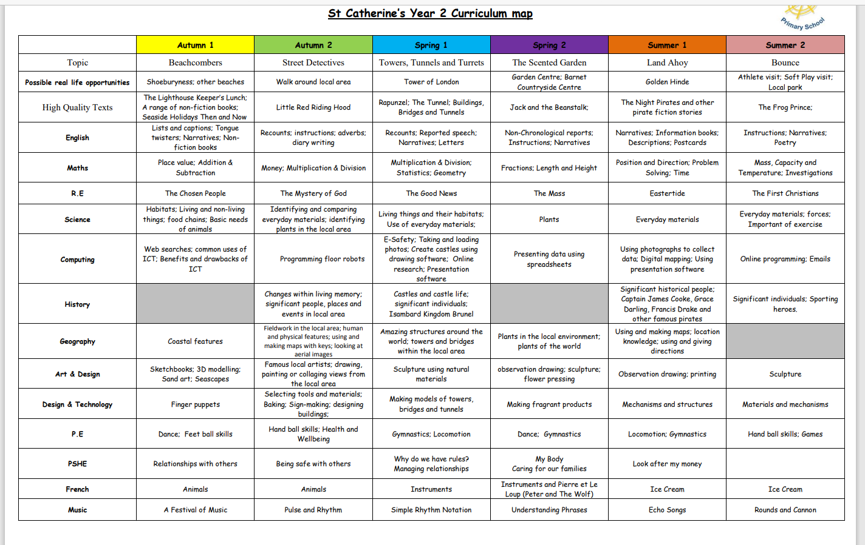

Slide 12
Maths Overview
3 levels of challenge:
Children must consider carefully what the task is and whether they feel they can attempt it from their understanding of the input.
No child should assume that they will choose the same level of challenge every lesson.
Aspirational and motivational names given to the challenges e.g. amazing, fantastic…

Slide 13
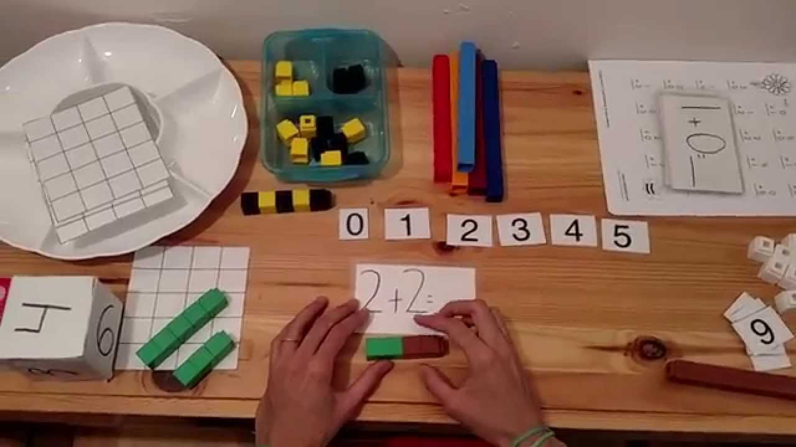
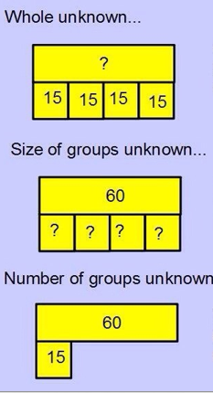
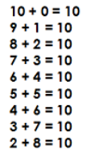
Maths Overview
Concrete, Pictorial, Abstract
Mastery of Concepts
-> use of language to justify and explain
Application of skills to real life problems

Slide 14
Literacy Overview
Writing:
Stamina for writing
Writing for a purpose
Spelling, Punctuation and Grammar Lessons
Handwriting
Reading:
Daily Guided Reading
Expose the children to rich vocabulary
Read TO and WITH your child
Phonics
Develop comprehension as well as fluency
Reading challenge – Colour a star for any book read. 30 books for bronze, silver and gold.
Notes:
- Reading records

Slide 15
Educational Trips
There will be regular trips throughout Year 2, they might be local or further afield.
Parent volunteers
Shoeburyness – Thursday 22 September

Slide 16
RE Overview
Prayer Life
-> 1 Prayer Service
-> 1 Class Mass
-> Gospel Assemblies
-> Collective Worship daily
-> Hymn Practice weekly
RE Curriculum
6 units
Liturgical Year (Advent/Lent)
PSHE and Collective Worship (links to RE)

Slide 17
Relationships and Health Education
Ten Ten’s programme for Catholic primary schools, Life to the Full, teaches Relationships Education and Health Education.
RSE is a statutory subject for all schools.
We are embracing “the challenges of creating a happy and successful adult life” by giving pupils knowledge “that will enable them to make informed decisions about their wellbeing, health and relationships” (DFE Statutory Guidance).
Life to the Full is a fully resourced Scheme of Work in Relationships Education for Catholic primary schools which embraces and fulfils the new statutory curriculum. Children will revisit the same topics at an age-appropriate stage through their school life.
The programme includes:
Lesson plans for Years 1 to 6; High-quality videos created by Ten Ten specifically for UK- based Catholic primary schools; Programme of prayer and worship music to accompany the scheme of work; Online Parent Portal for links to home.

Slide 18
Statutory Assessment
Happen throughout May
Conducted very informally
Reading, Maths and SPaG assessments
They will be used to inform Teacher Assessments
Past papers will be given to help prepare the children.
Outcomes are sent out in July

Slide 19
Home Learning
Ofsted say that homework should only be set if it’s appropriate to the needs of the children. This year we really want to focus on phonics, reading fluency and comprehension and maths.
An email will be sent weekly with the spelling - spelling assessments will begin w/c 19.09.22
Daily Reading – Library books and Home School Books to be changed each Thursday
A Maths activity will also be sent in the weekly email on Wednesdays

Slide 20
Safeguarding
Safeguarding Policy
Designated Safeguarding Officers
Miss Kelly
Miss Evans
Mrs. Whatley
Mrs. Ward

Slide 21
E-Safety
E – Safety Policy (on website)
Does your child have unsupervised access to a laptop or computer?
www.thinkuknow.co.uk
Parental Controls
Please inform us if you are aware of a child using it incorrectly, we have a responsibility to report it.
Please do not use your mobile phone when on the school site, this includes the playground. You may use them to take photographs and videos during prayer services and nativity performances.
Notes:
Mention e-safety lesson last week

Slide 22
Communication
Website
Newsletter
Texting Service
E-mails
Appointments via the office/ a quick chat after dismissal
Weekly Email
Notes:
Mention e-safety lesson last week

Slide 23
Reminders:
Pick up – return the Pick Up Arrangement Form sent last week/ inform the office of any changes
Children are expected to come to school in their PE kits on Monday and Wednesday. Shorts for gymnastics and Dance.
French with Madame Reeve and PE with Mr. Reilly on a Wednesday afternoon.
Year 2 will have music on a Wednesday with Ms. Draper.
Birthdays: Fruit from a tree or a book
Water Bottles in school every day
Messages to be emailed to the office
Forest School will begin in the Spring Term. Please send your child in with wellies on our forest school day.

Slide 24
Any questions?
Thank you for coming we look forward to working in partnership with you to support your children in reaching their full potential in Year 2.

