Slide 1
NEGATIVE NUMBERS

Slide 3
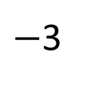
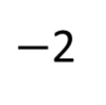
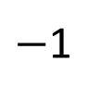
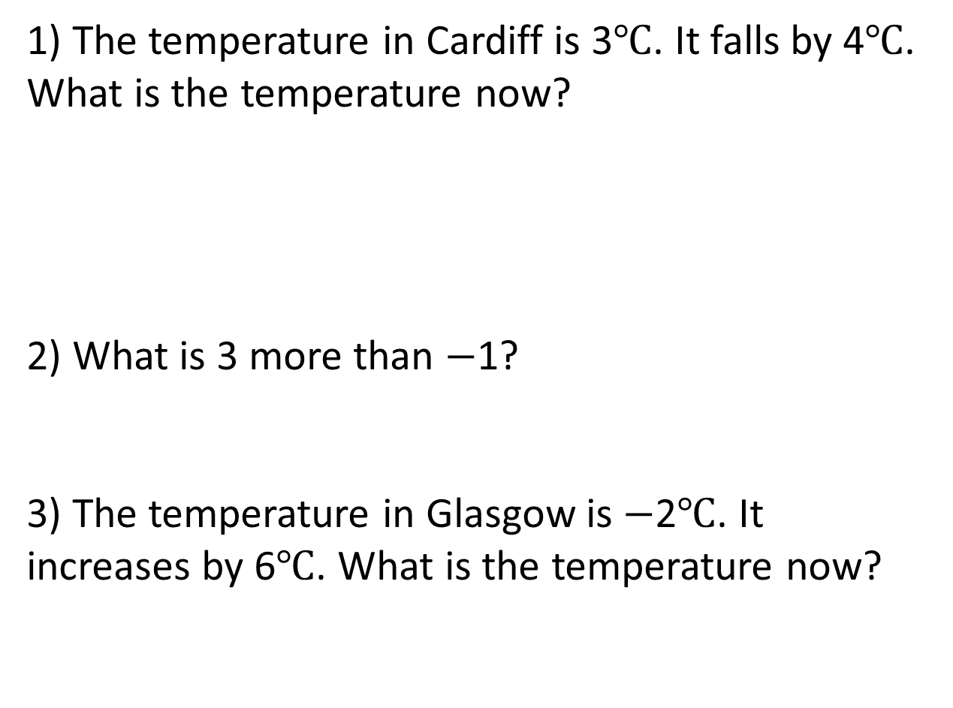
1) The temperature in Cardiff is 3$℃$. It falls by 4$℃$. What is the temperature now?
2) What is 3 more than $−$1?
3) The temperature in Glasgow is $−$2$℃$. It increases by 6$℃$. What is the temperature now?
$−$3
$−$2
$−$1
0
1
2
3

Slide 4
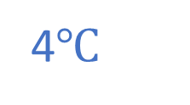
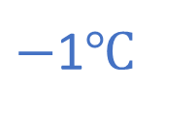
1) The temperature in Cardiff is 3$℃$. It falls by 4$℃$. What is the temperature now?
2) What is 3 more than $−$1?
3) The temperature in Glasgow is $−$2$℃$. It increases by 6$℃$. What is the temperature now?
$−$1$℃$
$−$3
$−$2
$−$1
0
1
2
3
2
4$℃$

Slide 6
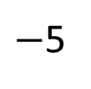
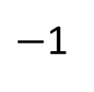
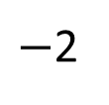
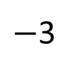
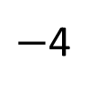
Have a think
The number line looks correct to me!
$−$1
$−$2
$−$3
$−$4
$−$5
0
1
2
3
4
5

Slide 7
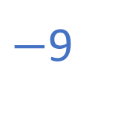
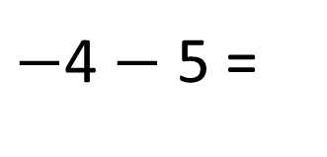
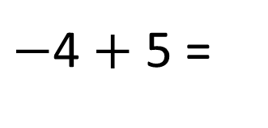
Have a think
$−$4 $+$ 5 =
1
$−$4 $−$ 5 =
$−$9
5 more than $−$4
5 less than $−$4
$−$10
$−$9
$−$8
$−$7
$−$6
$−$5
$−$4
$−$3
$−$2
$−$1
0
1
2
3
4
5
6
7
8
9
10
What’s the same and what’s different?

Slide 8
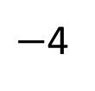
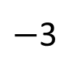
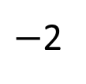
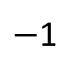
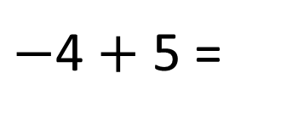
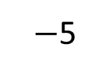
$−$4 $+$ 5 =
1
4
1
$−$5
$−$4
$−$3
$−$2
$−$1
0
1
2
3
4
5
4
1

Slide 9
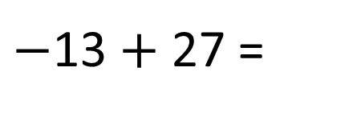
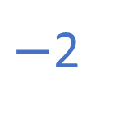

$−$4 $+$ 5 =
1
4
1
$−$5
$−$4
$−$3
$−$2
$−$1
0
1
2
3
4
5
2
4
4 $−$ 6 =
14
$−$2
$−$13 $+$ 27 =
4
2
13
14

Slide 10
Have a go at questions 1 - 5 on the worksheet

Slide 11
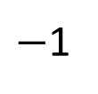
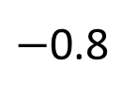
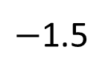
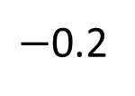
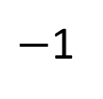
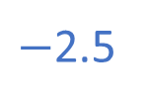
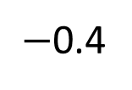
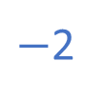
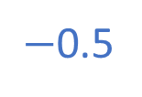
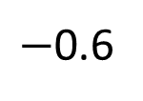
Complete the number lines
$−$2.5
$−$2
$−$1.5
$−$1
$−$0.5
0
0.5
1
1.5
2
2.5
2
$−$1
$−$0.8
$−$0.6
$−$0.4
$−$0.2
0
0.2
0.4
0.6
0.8
1
2 $÷$ 10 $=$ 0.2

Slide 12
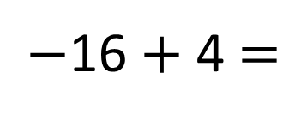
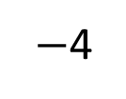
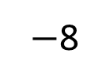
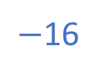
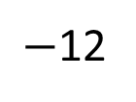

What is A $+$ B?
$−$16
24
4
A
$−$12
$−$8
$−$4
0
B
16
24 $÷$ 6 $=$ 4
$−$16 $+$ 4 $=$
$−$ 12
8
16
$−$8
0
16

Slide 13
Have a go at the rest of the worksheet

