Slide 3
Complete the number tracks.
1)
2)
3)
 |  |  |  | 100 | 125 | 150
 |  | 10 | 15 | 20
 | 50 | 100 | 150

Slide 4
Complete the number tracks.
1)
2)
3)
 |  |  |  | 100 | 125 | 150
0
25
50
75
 |  | 10 | 15 | 20
0
5
25
30
 | 50 | 100 | 150
0
200
250
300

Slide 6
Have a think
$−$5
$−$4
$−$3
$−$2
$−$1
0
1
2
3
4
5
Negative 1
Negative 2
Negative 3
Negative 4
Negative 5
Where have you seen negative numbers before?

Slide 7
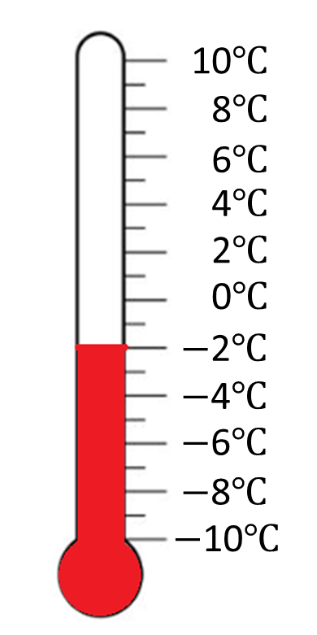
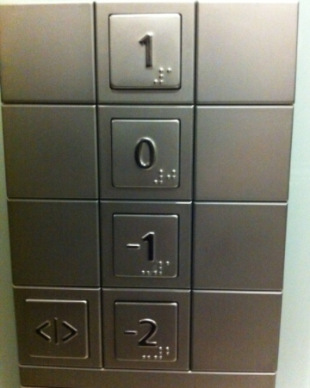
Temperature -
when the temperature is below freezing (0$℃$), it is shown as a negative number
Lift – negative numbers used for floors below ground level.
Negative numbers can be used to measure under sea level

Slide 8
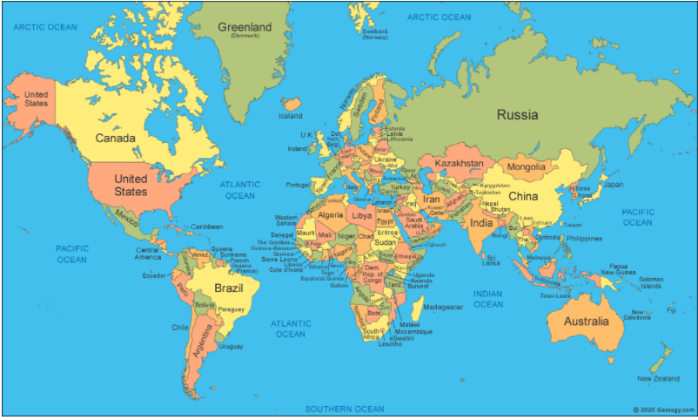
Research the average monthly temperature for these capital cities.
Ottawa (Capital of Canada)
Moscow (Capital of Russia)
Nuuk (Capital of Greenland)
Which temperatures are negative?
Which temperatures are positive?

Slide 9
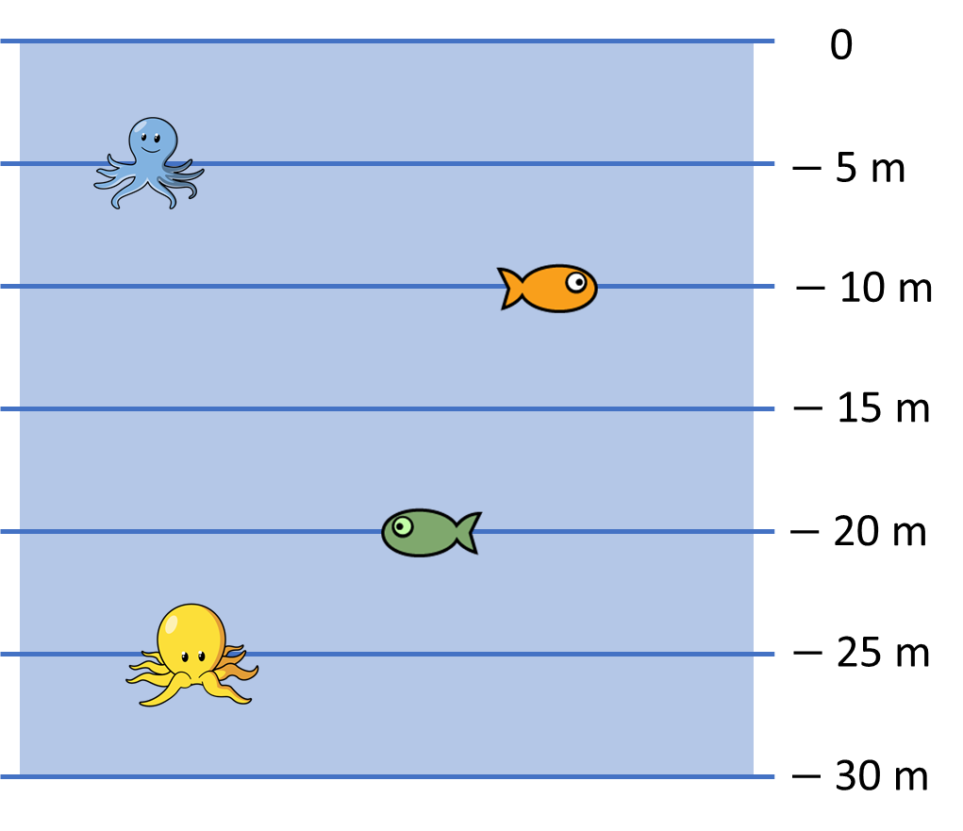
How far below sea level is the yellow octopus?
What other questions could you ask about the picture?
Negative 25 metres

Slide 10
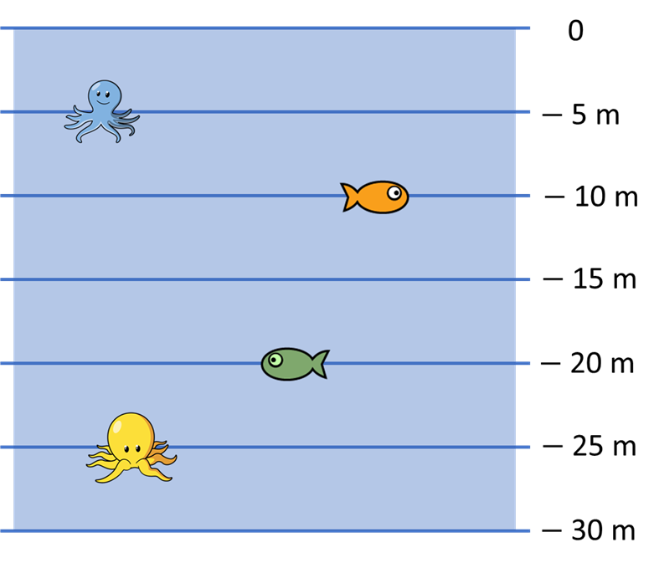
Draw your own underwater scene.
Describe the position of the different creatures or items using full sentences.

