Slide 1


Slide 3
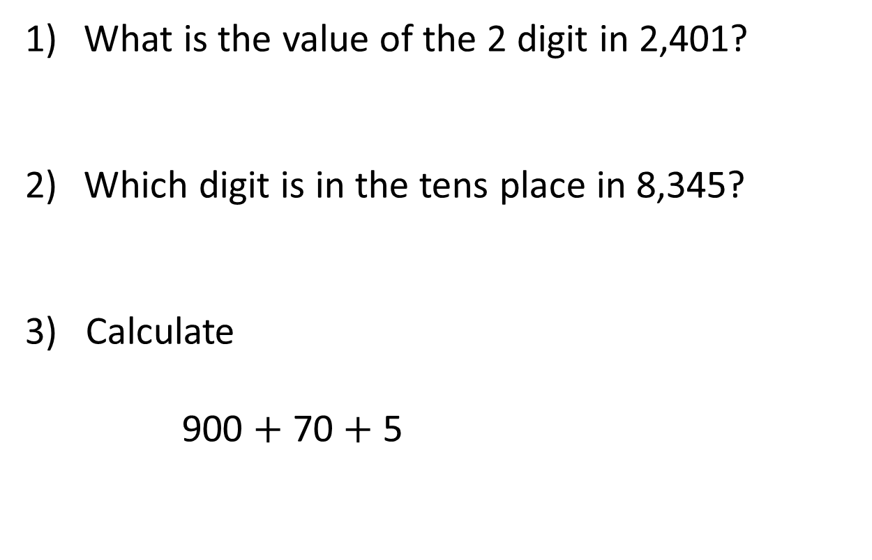
What is the value of the 2 digit in 2,401?
Which digit is in the tens place in 8,345?
3) Calculate
900 $+$ 70 $+$ 5

Slide 4
What is the value of the 2 digit in 2,401?
Which digit is in the tens place in 8,345?
3) Calculate
900 $+$ 70 $+$ 5
2,000
4
975

Slide 6




2,144
4
$$=$$
2,000
$$+$$
100
$$+$$
40
$$+$$
Thousands | Hundreds | Tens | Ones

Slide 7












Thousands | Hundreds | Tens | Ones
6,238
$$=$$
6,000
$$+$$
200
$$+$$
30
$$+$$
8
6,238
$$=$$
8
$$+$$
30
$$+$$
200
$$+$$
6,000

Slide 8





Have a think
Thousands | Hundreds | Tens | Ones
6,038
$$=$$
6,000
$$+$$
0
$$+$$
30
$$+$$
8
6,038
$$=$$
6,000
$$+$$
30
$$+$$
8

Slide 9
Have a go at question 1 on the worksheet

Slide 10
















Have a think
Thousands | Hundreds | Tens | Ones
3,412
$$=$$
3,000
$$+$$
400
$$+$$
10
$$+$$
2
3,412
$$=$$
3,000
$$+$$
300
$$+$$
110
$$+$$
2
3,412
$$=$$
3,200
$$+$$
200
$$+$$
10
$$+$$
2
3,412
$$=$$
$$+$$
100
$$+$$
$$+$$

Slide 11
5,692
5,000
2
600
90
5
6
5,692 is equal to thousands, hundreds,
tens and ones
9
2

Slide 12
Have a go at question 2 and 3 on the worksheet

Slide 13
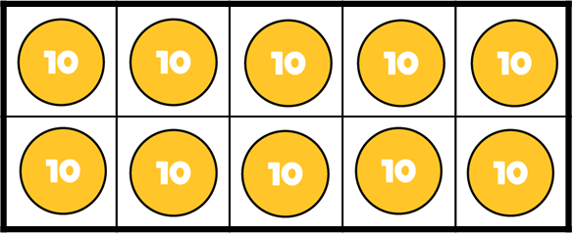


If
$$=$$
Then
$$=$$

Slide 14
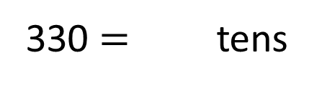
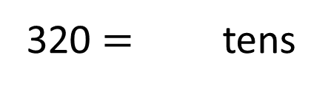
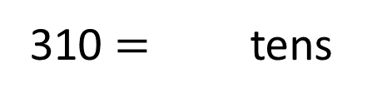
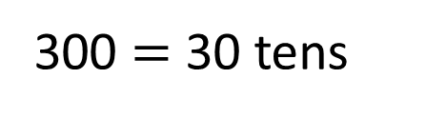
Have a think
If
300 $=$ 30 tens
Then
310 $=$ tens
31
320 $=$ tens
32
330 $=$ tens
33

Slide 15
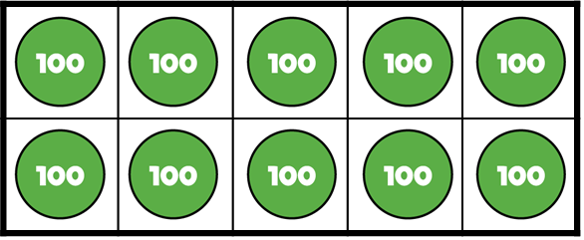


If
$$=$$
Then
$$=$$
How many hundreds are equal to 4,100?
41

Slide 16
Have a go at the rest of the worksheet

