Slide 1


Slide 3
1) Complete the sequence.
100, 200, 300, 400, _____ , _____
2) Write the missing numbers.
800, 700, ____, 500, 400, ____
3) What is 100 more than 800?
4) What is 100 less than 200?

Slide 4
1) Complete the sequence.
100, 200, 300, 400, _____ , _____
2) Write the missing numbers.
800, 700, ____, 500, 400, ____
3) What is 100 more than 800?
4) What is 100 less than 200?
500
600
600
300
900
100

Slide 6

1,000
1,000
1,000
1,000
1,000
1,000
1,000
1,000
1,000
1,000
one thousand
two thousand
three thousand
four thousand
five thousand
six thousand
seven thousand
eight thousand
nine thousand
ten thousand

Slide 7
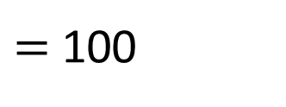
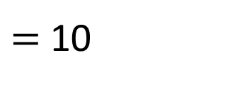
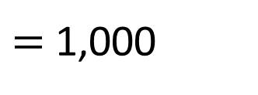
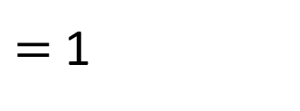
$=$ 1
$=$ 10
$=$ 100
$=$ 1,000

Slide 8
10,000
2,000
9,000
8,000
7,000
6,000
5,000
4,000
1,000
3,000
seven thousand
six thousand
five thousand
four thousand
three thousand
two thousand
one thousand
ten thousand
nine thousand
eight thousand

Slide 9
Have a go at questions
1 - 6 on the worksheet

Slide 10
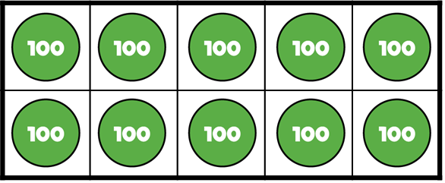
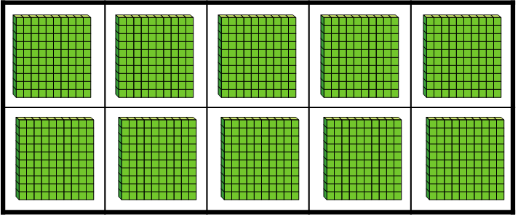
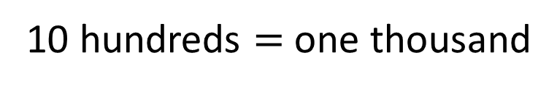
There are 10 hundreds.
10 hundreds $=$ one thousand
What’s the same?
What’s different?

Slide 11



Have a think
Which representations show 4,000?

Slide 12
Have a think
Which representations show 4,000?

Slide 13
Have a go at the rest of the worksheet

