Slide 3
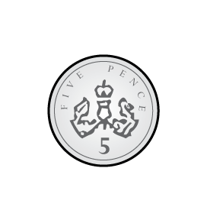
1) How many fingers?
2) What is the total amount?
What comes next?
5, 10, 15, 20, 25 ___
What comes next?
50, 100, 150, 200, 250 ___

Slide 4
1) How many fingers?
2) What is the total amount?
What comes next?
5, 10, 15, 20, 25, ___
What comes next?
50, 100, 150, 200, 250, ___
5
10
15
20
15 p
30
300

Slide 6
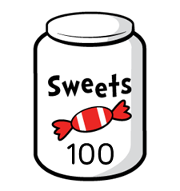
How many sweets are there altogether?
50
50
50
50
50
50
50
50
100
150
200
250
300
350
There are 350 sweets altogether.

Slide 7
Complete the number tracks.
50 | 100 |  | 200 |  | 300 | 350
150
250
400
450
900 | 850 | 800 |  | 700 |  | 600 | 550
750
650
500

Slide 8
Which number is in the wrong place?
Multiple of 50
Not multiple of 50
750
480
50
230
150
290
1000
550
300
540
150
520
Have a think

Slide 9
Have a go at questions 1 - 4 on the worksheet

Slide 10
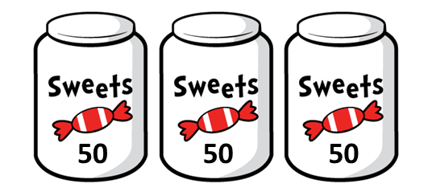
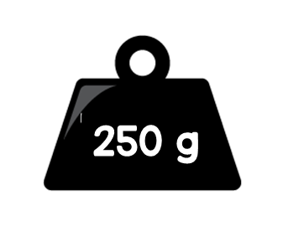

Use $<$, $>$ or $=$ to complete each comparison.
150
200
$$<$$
250 g
$$=$$
Have a think

Slide 11
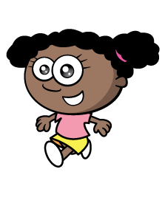
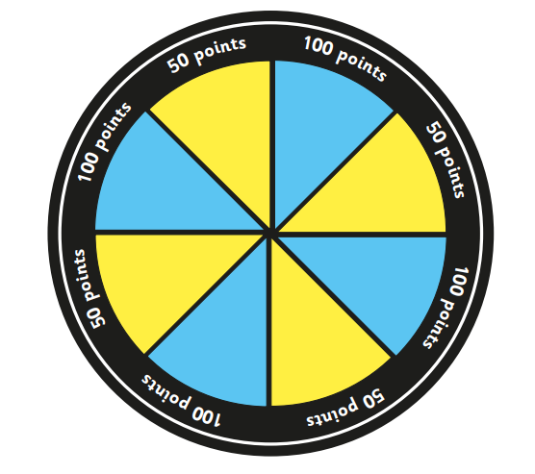
What is Whitney’s score?
200

Slide 12
What other possible scores could you make with 3 tiddlywinks?
200
150
250
300
Have a think

Slide 13
Have a go at the rest of the questions on the worksheet

