Slide 1


Slide 3
Write the numbers in numerals.
1) One hundred and forty
2) One hundred and four
3) Four hundred and one
4) Four hundred and forty-one

Slide 4
Write the numbers in numerals.
1) One hundred and forty
2) One hundred and four
3) Four hundred and one
4) Four hundred and forty-one
140
104
401
441

Slide 6
Hundreds | Tens | Ones
3
4
6

Slide 7
Hundreds | Tens | Ones
2
5
2

Slide 8
Hundreds | Tens | Ones
4
3
0
Hundreds | Tens | Ones
0
4
3

Slide 9
Have a go at questions
1 - 3 on the worksheet

Slide 10
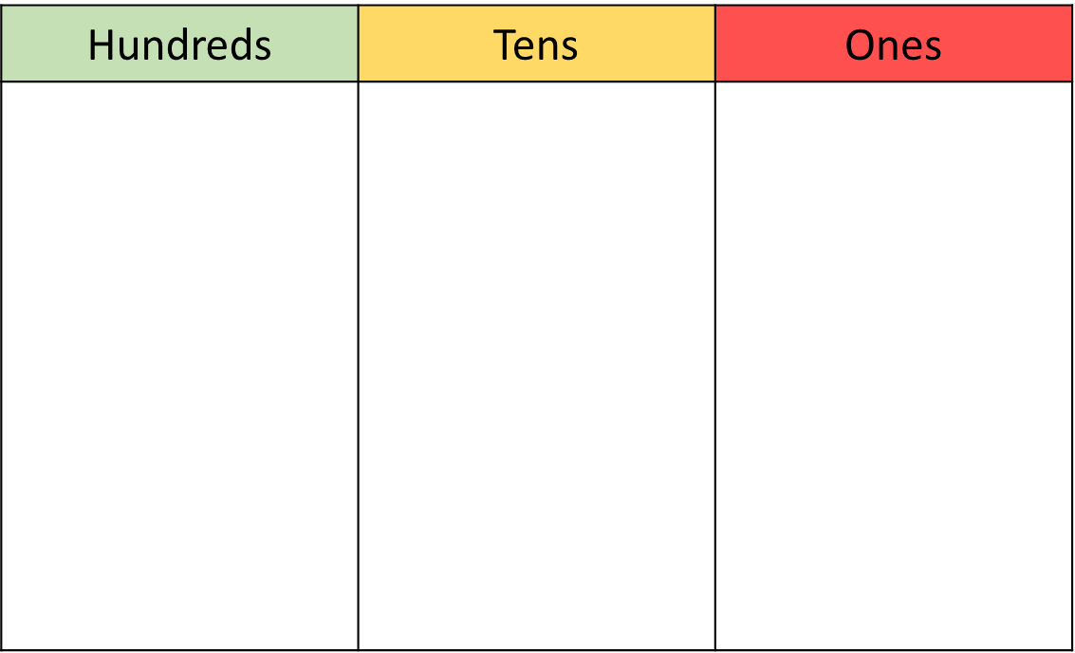
Three hundred and five
3
0
5
Three hundred and fifty
3
5
0

Slide 11
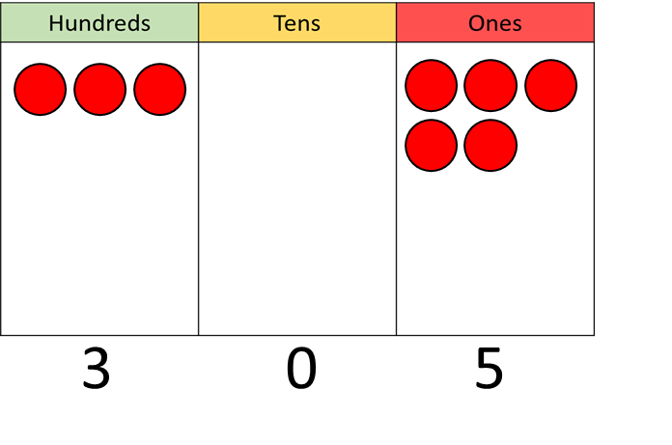
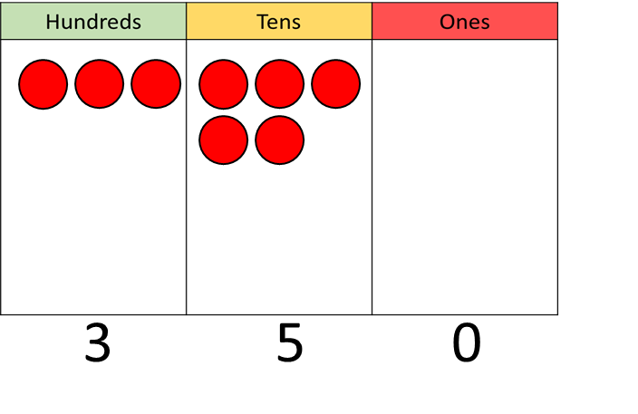

Which of the numbers below can be made
with 8 counters?
611
802
233
314
Have a think

Slide 12




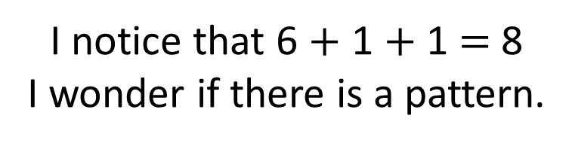
611
802
233
314
I notice that 6 $+$ 1 $+$ 1 $=$ 8
I wonder if there is a pattern.

Slide 13
Have a go at questions
4 - 6 on the worksheet

Slide 14

Teddy has made 201 on the place value grid.
He moves one counter to make a new number.
What could his new number be?
2
0
1
Have a think

Slide 15
1
1
1
1
0
2
2
0
1
3
0
0
2
1
0

Slide 16
Have a go at the rest of the worksheet

