Slide 1


Slide 3
Write the numbers in words.
1) 26
2) 15
3) 89
4) 34

Slide 4
Write the numbers in words.
1) 26
2) 15
3) 89
4) 34
twenty-six
fifteen
eighty-nine
thirty-four

Slide 6
Write the number in digits and words.
Four hundred and twenty-five
4
2
5

Slide 7


Write the number in numerals and words.
1
The number is two hundred and fifty.
2
5
The number is two hundred and fifteen.

Slide 8
Have a go at questions
1 - 3 on the worksheet

Slide 9
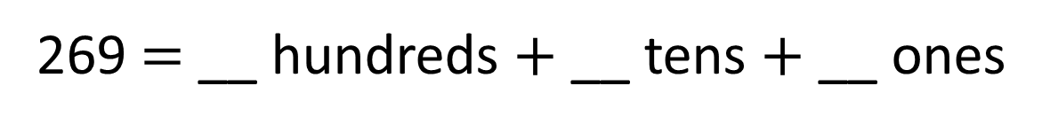


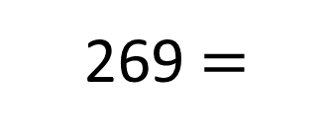
Partition the number into 100s, 10s and 1s
2
6
9
269 $=$ __ hundreds $+$ __ tens $+$ __ ones
$$+$$
$$+$$
269 $=$
200
60
9

Slide 10
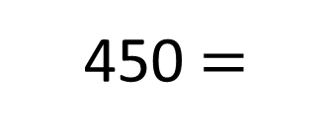
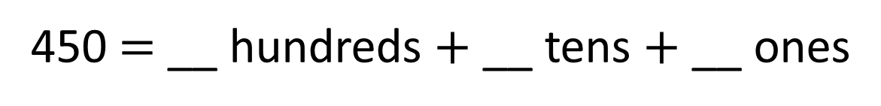

Partition the number into 100s, 10s and 1s
4
5
0
450 $=$ __ hundreds $+$ __ tens $+$ __ ones
$$+$$
450 $=$
400
50

Slide 11

What is the value of the 6 in each number?
H
T
O
462
621
206
60
6 tens
600
6 hundreds
6
6 ones
Have a think

Slide 12
Have a go at questions
4 - 6 on the worksheet

Slide 13

Dexter is making numbers using digit cards.
What 3-digit numbers could Dexter make?
3
6
7
367
376

Slide 14

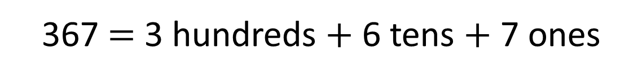
Dexter is making numbers using digit cards.
What 3-digit numbers could Dexter make?
3
7
6
Have a think
367
376
673
637
736
763
Can you partition the numbers?
367 $=$ 3 hundreds $+$ 6 tens $+$ 7 ones
367 $=$ 300 $+$ 60 $+$ 7

Slide 15
Have a go at the rest of the worksheet

