Slide 1


Slide 3


1) How many pencils?
2) How many pencils?
3) How many pencils?
100
pencils
100
pencils
100
pencils
100
pencils
100
pencils

Slide 4
1) How many pencils?
2) How many pencils?
3) How many pencils?
100
pencils
100
pencils
100
pencils
100
pencils
100
pencils
500
40
8

Slide 6
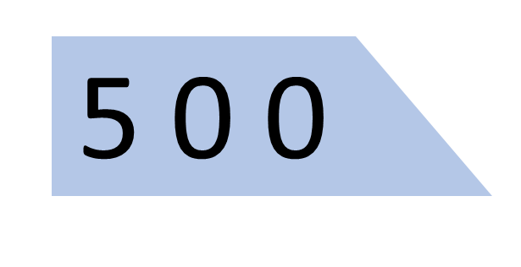


How many pencils altogether?
100
pencils
100
pencils
100
pencils
100
pencils
100
pencils

Slide 7



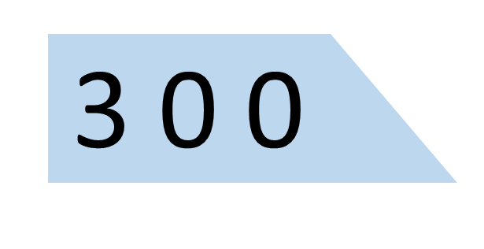


How many sweets are there altogether?
There are 364 sweets.

Slide 8
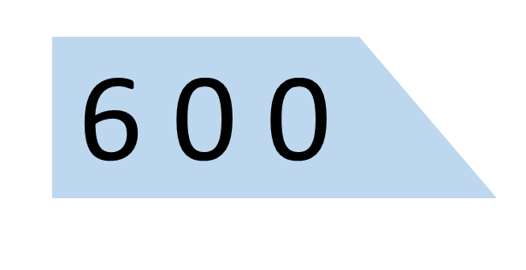

How many sweets are there altogether?
There are 605 sweets.

Slide 9
Have a go at questions
1 - 3 on the worksheet.

Slide 10
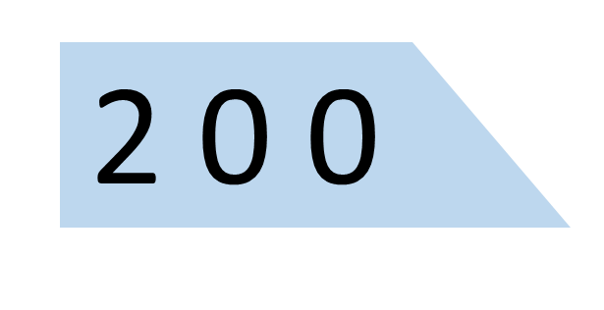

What number has been made?

Slide 11

Have a think
What number has been made?
3
4
7

Slide 12



Have a think
Which base 10 pieces are hidden?

Slide 13
Have a go at questions
4 - 7 on the worksheet

Slide 14
Have a think
What number has been made?
2
2
1
12
8

Slide 15
Have a go at the rest of the questions on the worksheet

