Slide 1


Slide 3
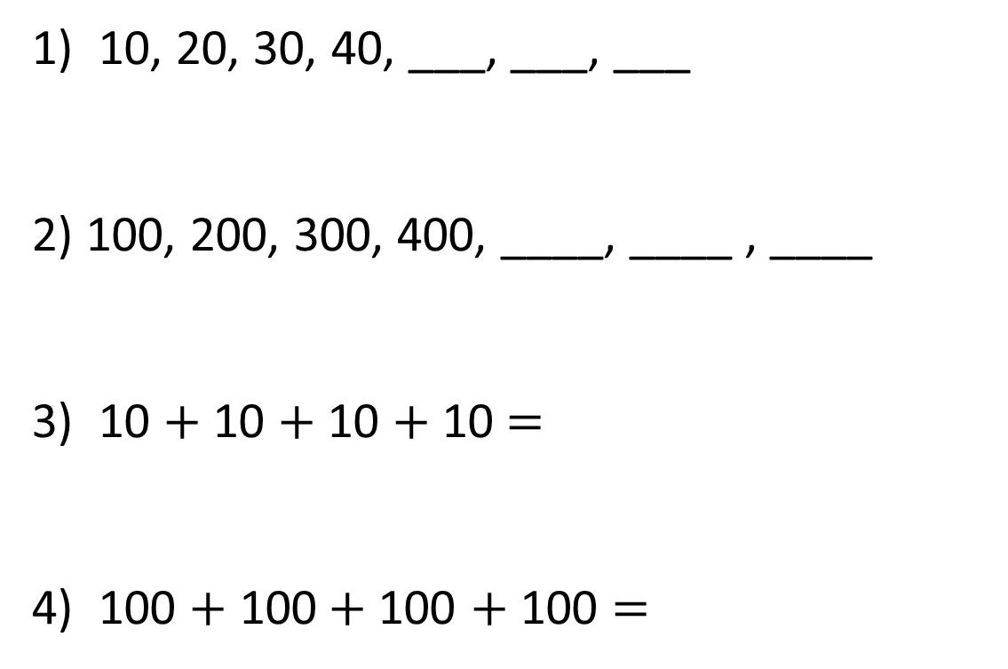
1) 10, 20, 30, 40, ___, ___, ___
2) 100, 200, 300, 400, ____, ____ , ____
3) 10 $+$ 10 $+$ 10 $+$ 10 $=$
4) 100 $+$ 100$+$100 $+$ 100 $=$

Slide 4
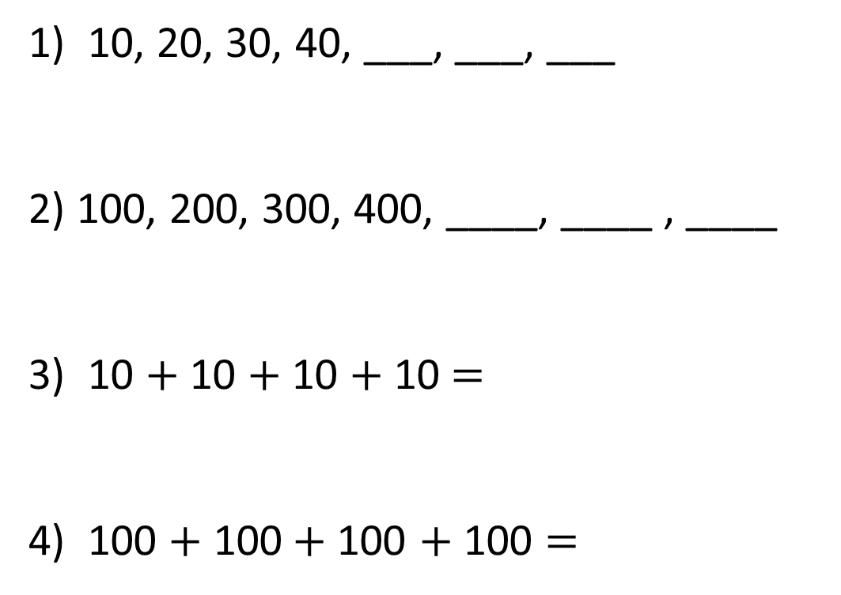
50
60
70
1) 10, 20, 30, 40, ___, ___, ___
2) 100, 200, 300, 400, ____, ____ , ____
3) 10 $+$ 10 $+$ 10 $+$ 10 $=$
4) 100 $+$ 100$+$100 $+$ 100 $=$
500
600
700
40
400

Slide 6


What does 100 look like?

Slide 7



What does 100 look like?

Slide 8
What does 100 look like?
100 ones is equal to 1 hundred.

Slide 9
What does 100 look like?
10 tens is equal to 1 hundred.

Slide 10

Which show 100?
Have a think

Slide 11

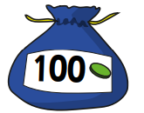
How many pencils?
100
pencils
100
pencils
100
pencils
100
pencils
400
How many counters?
700

Slide 12
Have a go at questions 1 - 4 on the worksheet

Slide 13

How many pencils?
100
pencils
100
pencils
100
pencils
100
pencils
100
pencils
100
pencils
100
pencils
100
pencils
100
pencils
100
pencils
There are ten hundred

Slide 14
What does 1,000 look like?
100
200
300
400
500
600
700
800
900
1,000
10 hundreds is equal to 1 thousand

Slide 15

















$+$ 100
$+$ 100
Have a think
$+$ 100
$+$ 100
 |  | 500 | 600 | 700
300
400
800
900
$−$ 100
$−$ 100
$−$ 100
$−$ 100
$−$ 100
$−$ 100
$−$ 100
$−$ 100
$−$ 100
 | 900 | 800 |  | 600
1,000
700
500
400
$+$ 100
$+$ 100
$+$ 100
$+$ 100

Slide 16
Have a go at the rest of the worksheet

