Slide 1


Slide 3

1) 20 $+$ 10 $=$
2) 60 $+$ 10 $=$
3) 50 $+$ 10 $+$ 10 $=$
4) 20 $+$ 20 $+$ 10 $=$

Slide 4

1) 20 $+$ 10 $=$
2) 60 $+$ 10 $=$
3) 50 $+$ 10 $+$ 10 $=$
4) 20 $+$ 20 $+$ 10 $=$
30
70
70
50

Slide 6
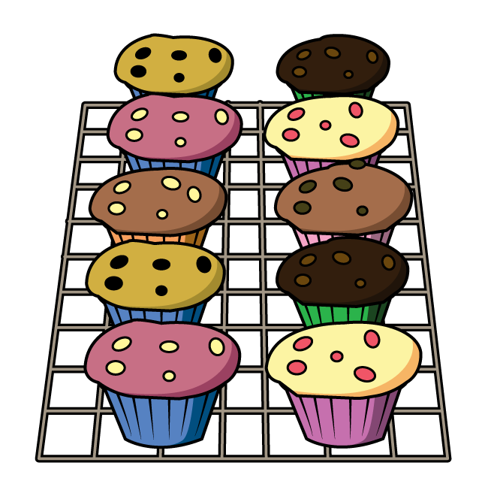



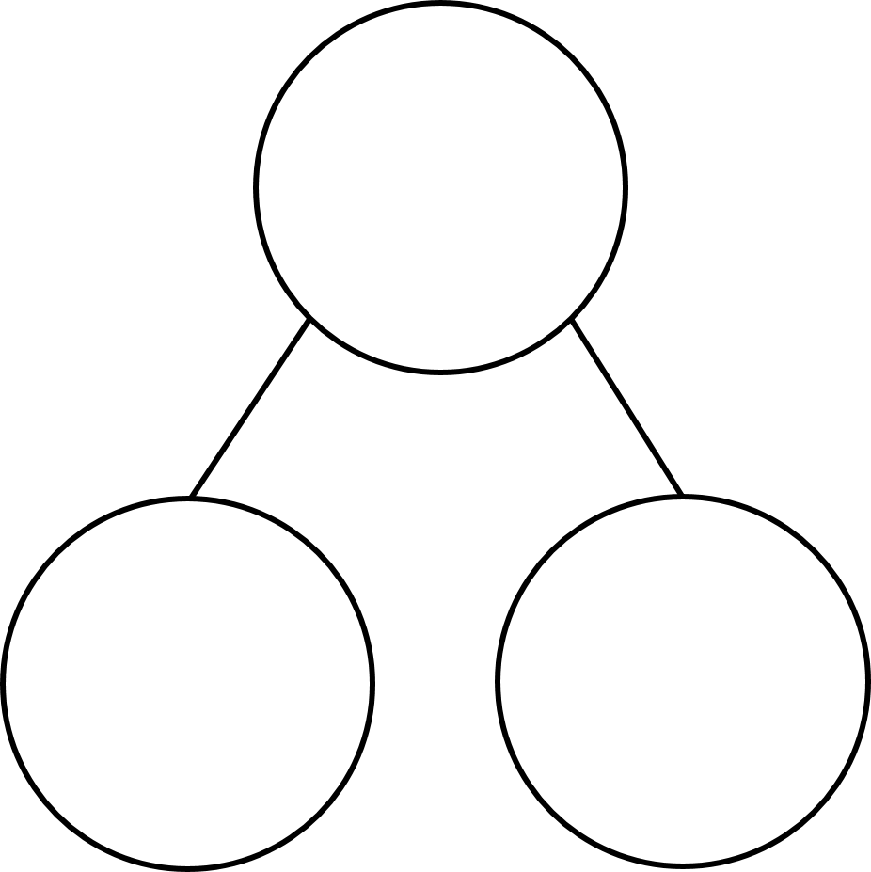

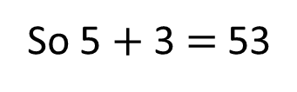
How many cakes?
There are ___ tens and ___ ones.
.
5
3
53
So 5 $+$ 3 $=$ 53
50
3

Slide 7



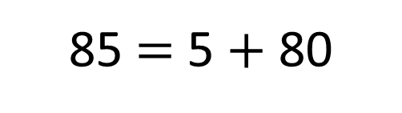
Which is the odd one out?
Have a think
85 $=$ 5 $+$ 80
5
80
85

Slide 8
Which is the odd one out?
85 $=$ 5 $+$ 80
5
80
85

Slide 9
Have a go at questions 1 - 4 on the worksheet

Slide 10
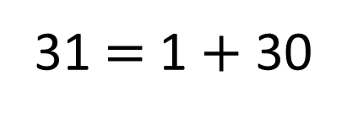
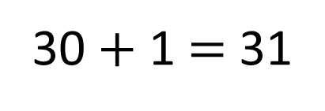
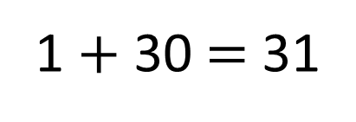
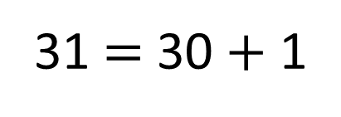
Write an addition sentence to match the part-whole model.
31
30 $+$ 1 $=$ 31
1 $+$ 30 $=$ 31
31 $=$ 1 $+$ 30
31 $=$ 30 $+$ 1

Slide 11


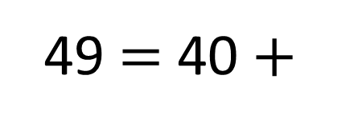
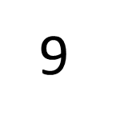
49 $=$ 40 $+$
9
?
40
49
9

Slide 12
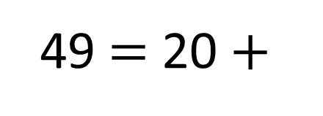
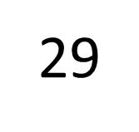
Have a think
49 $=$ 20 $+$
?
29
20
49
29

Slide 13
Have a go at the rest of the worksheet

