Slide 1


Slide 3
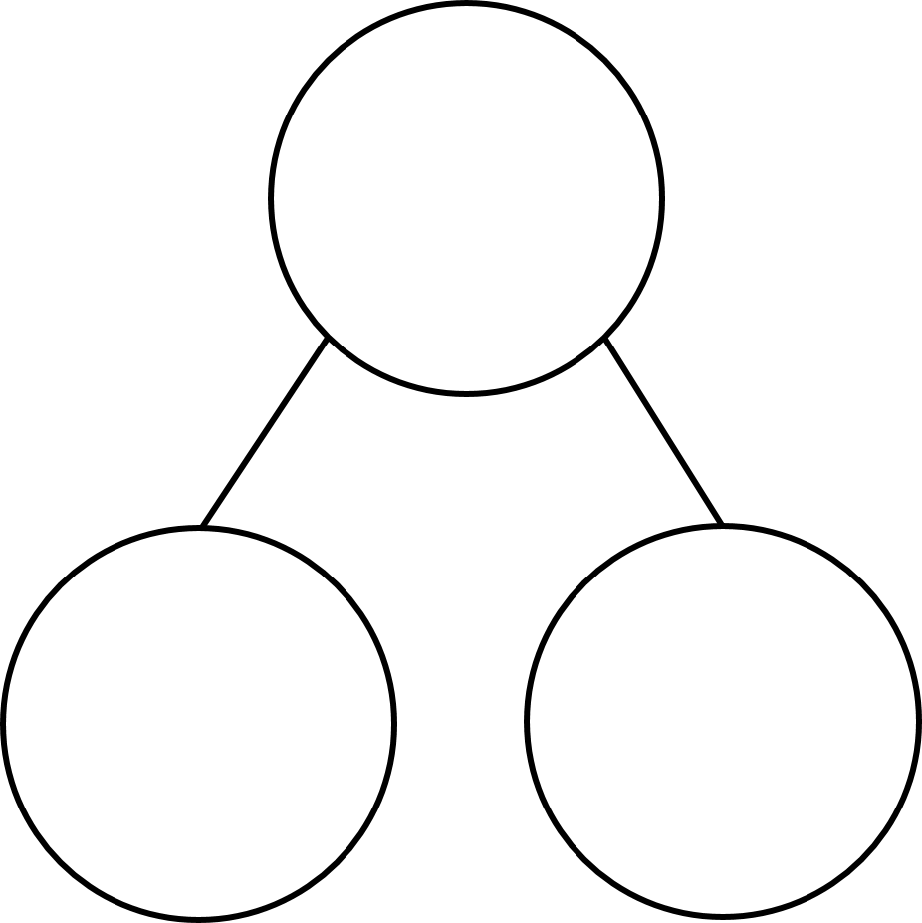
Complete the part-whole models
1)
2)
3)

Slide 4
Complete the part-whole models
1)
2)
3)
7
5
0

Slide 6

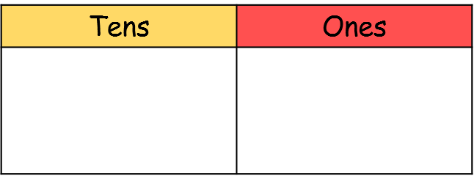
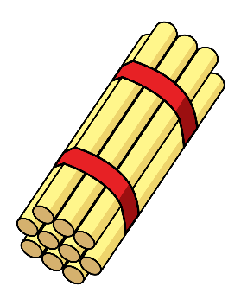

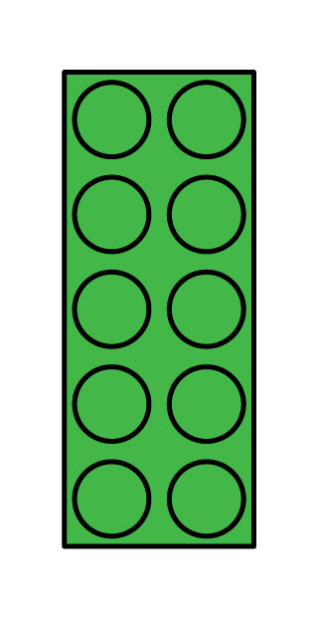

Have a think
24
15
41

Slide 7
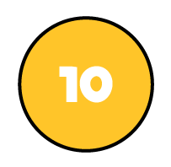

Have a think
24
56
24

Slide 8


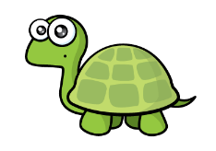
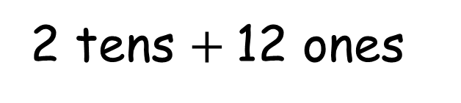
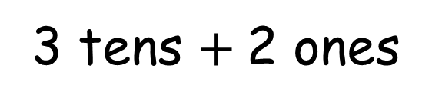
32
3 tens $+$2 ones
2 tens $+$12 ones

Slide 9
Have a go at questions 1 and 2 on the worksheet

Slide 10
Have a think
16

Slide 11
Have a think
16
24

Slide 12
Have a go at questions 3 - 5 on the worksheet

