Slide 1
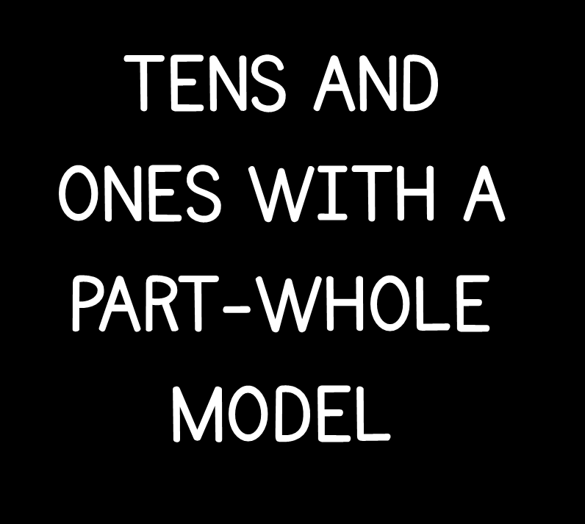

Slide 3






Which represents the number?
25
56
13

Slide 4
Which represents the number?
25
56
13

Slide 6
13

Slide 7

Have a think
15

Slide 8
Have a think
19

Slide 9
Have a think
29 is made up of 2 tens and 9 ones.
29

Slide 10
Have a think
0
29
29 is made up of __ tens and __ ones
29
29

Slide 11
Have a think
1
19
29 is made up of __ ten and __ ones
29
29

Slide 12
Have a think
25
2
5
__ is made up of __ tens and __ ones
20
29
?

Slide 13
Have a go at questions 1 - 4 on the worksheet

Slide 14


Have a look
36
10
20
16
10
10
8
6
8
3
6
36
__ tens and __ ones = __
2
16
36
__ tens and __ ones = __

Slide 15
Have a go at the rest of the worksheet

