Slide 1


Slide 3
Can you match the numerals with the words?
5
ten
10
thirty five
13
five
35
thirteen

Slide 4
Can you match the numerals with the words?
5
ten
10
thirty five
13
five
35
thirteen

Slide 5


Slide 6

Have a think
1 | 2 | 3 | 4 | 5 | 6 | 7 | 8 | 9 | 10
one
eight
too
four
won
two
ate
for

Slide 7
What do you notice?
1 | 2 | 3 | 4 | 5 | 6 | 7 | 8 | 9 | 10
11 | 12 | 13 | 14 | 15 | 16 | 17 | 18 | 19 | 20
21 | 22 | 23 | 24 | 25 | 26 | 27 | 28 | 29 | 30
31 | 32 | 33 | 34 | 35 | 36 | 37 | 38 | 39 | 40
41 | 42 | 43 | 44 | 45 | 46 | 47 | 48 | 49 | 50
51 | 52 | 53 | 54 | 55 | 56 | 57 | 58 | 59 | 60
61 | 62 | 63 | 64 | 65 | 66 | 67 | 68 | 69 | 70
71 | 72 | 73 | 74 | 75 | 76 | 77 | 78 | 79 | 80
81 | 82 | 83 | 84 | 85 | 86 | 87 | 88 | 89 | 90
91 | 92 | 93 | 94 | 95 | 96 | 97 | 98 | 99 | 100
twenty
thirty
forty
fifty
sixty
seventy
eighty
ninety

Slide 8
What do you notice?
1 | 2 | 3 | 4 | 5 | 6 | 7 | 8 | 9 | 10
11 | 12 | 13 | 14 | 15 | 16 | 17 | 18 | 19 | 20
21 | 22 | 23 | 24 | 25 | 26 | 27 | 28 | 29 | 30
31 | 32 | 33 | 34 | 35 | 36 | 37 | 38 | 39 | 40
41 | 42 | 43 | 44 | 45 | 46 | 47 | 48 | 49 | 50
51 | 52 | 53 | 54 | 55 | 56 | 57 | 58 | 59 | 60
61 | 62 | 63 | 64 | 65 | 66 | 67 | 68 | 69 | 70
71 | 72 | 73 | 74 | 75 | 76 | 77 | 78 | 79 | 80
81 | 82 | 83 | 84 | 85 | 86 | 87 | 88 | 89 | 90
91 | 92 | 93 | 94 | 95 | 96 | 97 | 98 | 99 | 100
eleven
twelve
thirteen
fourteen
fifteen
sixteen
seventeen
eighteen
nineteen

Slide 9
Have a go at questions 6 and 7 on the worksheet

Slide 10
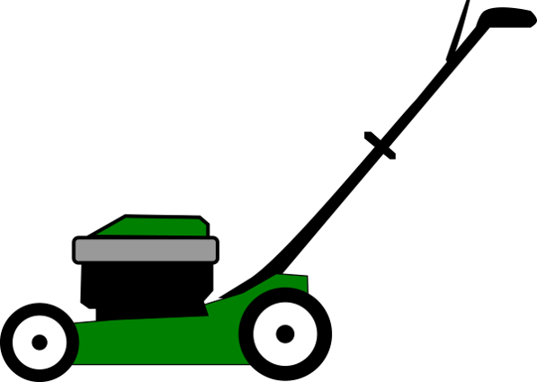

Have a think
1 | 2 | 3 | 4 | 5 | 6 | 7 | 8 | 9 | 10
11 | 12 | 13 | 14 | 15 | 16 | 17 | 18 | 19 | 20
21 | 22 | 23 | 24 | 25 | 26 | 27 | 28 | 29 | 30
31 | 32 | 33 | 34 | 35 | 36 | 37 | 38 | 39 | 40
41 | 42 | 43 | 44 | 45 | 46 | 47 | 48 | 49 | 50
51 | 52 | 53 | 54 | 55 | 56 | 57 | 58 | 59 | 60
61 | 62 | 63 | 64 | 65 | 66 | 67 | 68 | 69 | 70
71 | 72 | 73 | 74 | 75 | 76 | 77 | 78 | 79 | 80
81 | 82 | 83 | 84 | 85 | 86 | 87 | 88 | 89 | 90
91 | 92 | 93 | 94 | 95 | 96 | 97 | 98 | 99 | 100

Slide 11
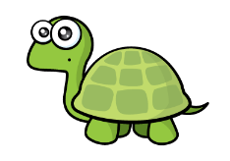
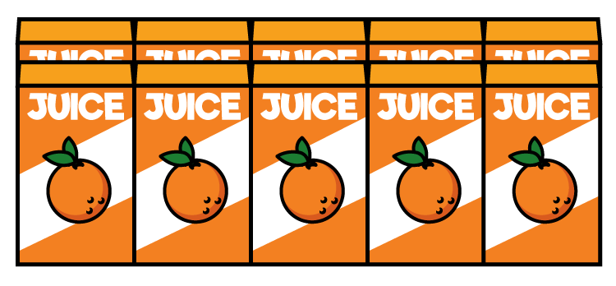
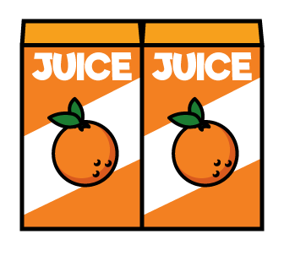
Have a think
42

Slide 12
Have a think
TO
43
42
53

Slide 13
Have a go at questions
8 and 9 on the worksheet

