Slide 1


Slide 3
What number is represented by
the base ten?
2) Make the number 15 using base ten.
3) 0, 10, 20, , .

Slide 4
What number is represented by
the base ten?
2) Make the number 15 using base ten.
3) 0, 10, 20, , .
11
30
40

Slide 6
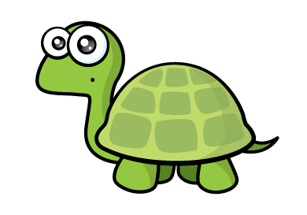





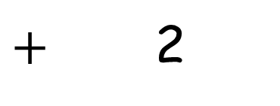
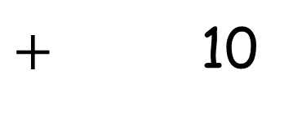
There are 2 tens and 2 ones
10
$+$ 10
$+$ 2

Slide 7
T O
There are 2 tens
and 2 ones
2
2
2
There are 3 tens and 2 ones
3
5
There are 3 tens and 5 ones
3

Slide 8
Have a go at questions 1 and 2 on the worksheet

Slide 9

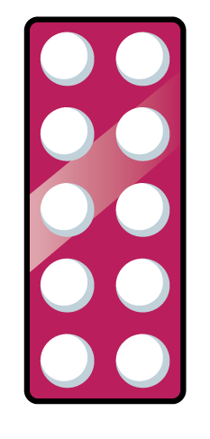



Have a think
3
43
4
34

Slide 10


1 ten and 6 ones $=$
16

Slide 11
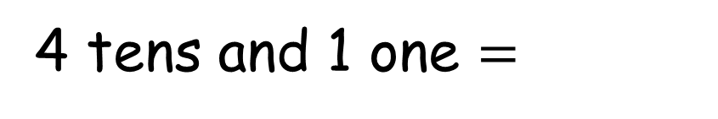
4 tens and 1 one $=$
41

Slide 12
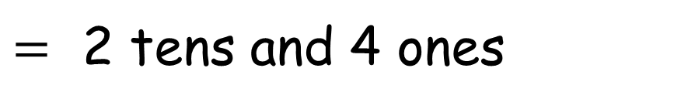
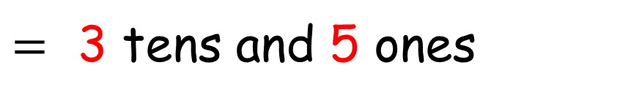
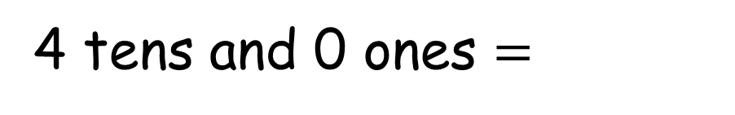

Have a think
35
$=$ 3 tens and 5 ones
24
$=$ 2 tens and 4 ones
1 ten and 9 ones $=$
19
4 tens and 0 ones $=$
40

Slide 13
Have a go at questions 3 and 4 on the worksheet

