Slide 1


Slide 3
1) How many counters are there in the ten frame?
2) Make the number 10
3) 8, 9, 10, 11 , , .

Slide 4
1) How many counters are there in the ten frame?
2) Make the number 10
3) 8, 9, 10, 11 , , .
9
12
13

Slide 6

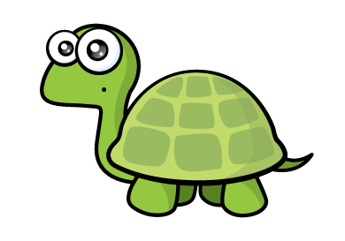

Slide 7



There is 1 ten
and 0 ones
10
There is 1 ten and 1 one
11
There is 1 ten and 2 ones
12

Slide 8





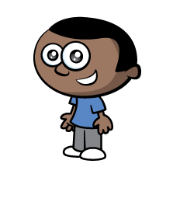


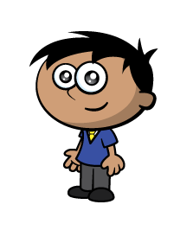
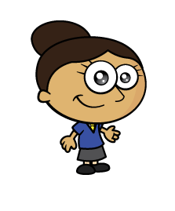



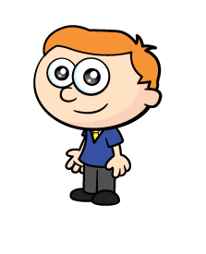
There is 1 ten
There is 1 ten and 3 ones

Slide 9
Have a go at questions 1 and 2 on the worksheet

Slide 10



Have a think

Slide 11







13
Have a think
18

Slide 12
Have a think

Slide 13
Have a go at questions 3 and 4 on the worksheet

