Slide 3
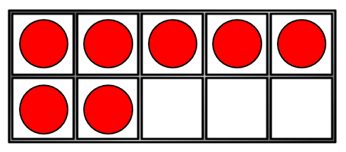
1) These are in order from ________ to ________
2) What is one more than 1?
3) What colour is the third bear?
4) How many counters?

Slide 4
greatest
1) These are in order from ________ to ________
2) What is one more than 1?
3) What colour is the third bear?
4) How many counters?
smallest
2
green
7

Slide 6
Number tracks and Number lines
1 | 2 | 3 | 4 | 5 | 6 | 7 | 8 | 9 | 10
0 | 1 | 2 | 3 | 4 | 5 | 6 | 7 | 8 | 9 | 10
What is the same?
What is different?

Slide 7
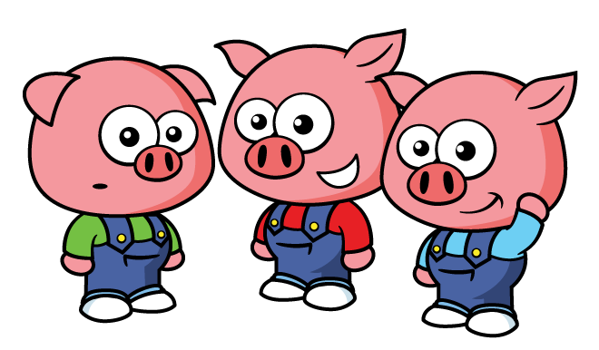
Finding numbers on a number line
0 | 1 | 2 | 3 | 4 | 5 | 6 | 7 | 8 | 9 | 10
How many pears?
How many pigs?

Slide 8
Have a think
0 | 1 | 2 | 3 | 4 | 5 | 6 | 7 | 8 | 9 | 10
How many?

Slide 9
Finding numbers on a number line
0 | 1 | 2 | 3 | 4 | 5 | 6 | 7 | 8 | 9 | 10
Find the number 9
What is one less than 9?

Slide 10
Have a think
0 | 1 | 2 | 3 | 4 | 5 | 6 | 7 | 8 | 9 | 10
Find the number three.
What is one more than three?

Slide 11
Have a think
0 | 1 | 2 | 3 | 4 | 5 | 6 | 7 | 8 | 9 | 10
What is the first number?
What is the last number?

Slide 12
Have a go at question 1 on the worksheet

Slide 13
Have a think
What numbers are missing?
0
1
2
3
4
5
6
7
8
9
10
If we count on, we can fill in the missing numbers!

Slide 14
Have a think
What numbers are missing?
3
4
5
6
7
8
9
I can only
count on from 1

Slide 15
Have a go at question 2 on the worksheet

Slide 16
Making jumps on a number line
1
2
3
4
0
1
2
3
4
5
6
7
8
9
10
How many jumps from 5 is 9?
4

Slide 17
Have a think
Making jumps on a number line
0
1
2
3
4
5
6
7
8
9
10
How many jumps from two is four?
2

Slide 18
Have a go at the last question on the worksheet

