Slide 3
1) One more than two is ___
2) One less than 10 is ___
3) How many bees?
4) What number comes next? 3, 4, 5, ___

Slide 4
1) One more than two is ___
2) One less than 10 is ___
3) How many bees?
4) What number comes next? 3, 4, 5, ___
3
9
5
9

Slide 6
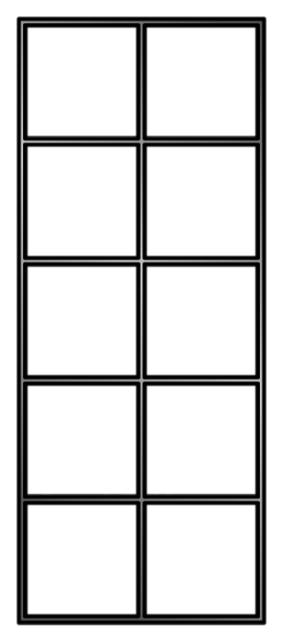
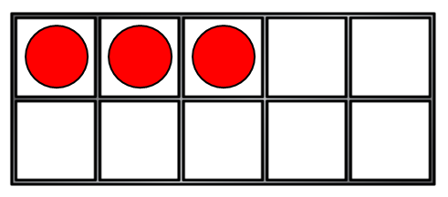
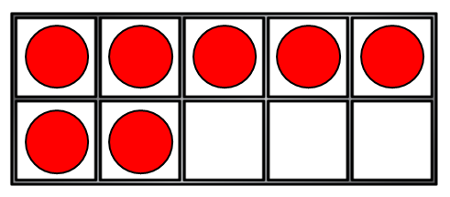
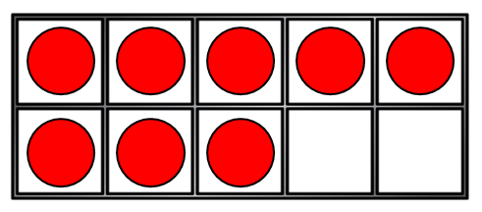
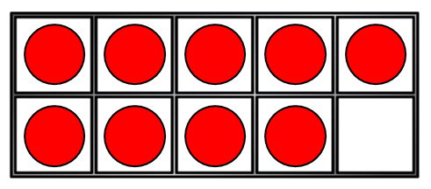
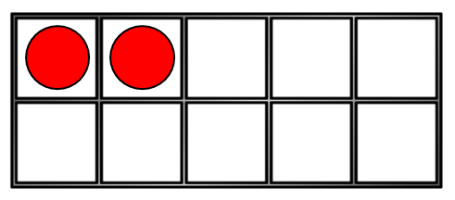
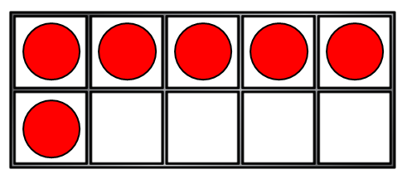
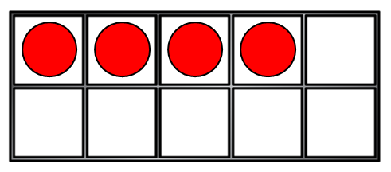
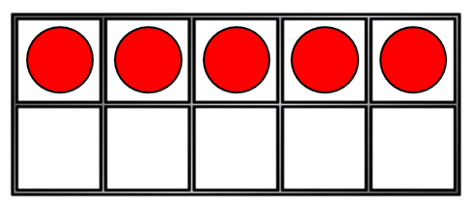
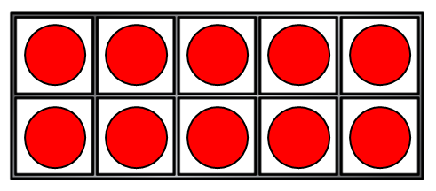
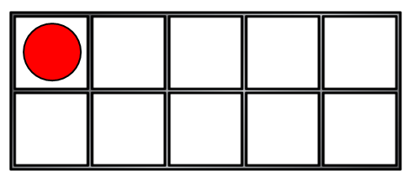
3
?
4
,6
7
,5
smallest
greatest
From to

Slide 7
8
?
6
7
greatest
smallest
From to
Have a think

Slide 8
Order with number tracks
10
4
6
1 | 2 | 3 | 4 | 5 | 6 | 7 | 8 | 9 | 10
smallest
greatest
From to

Slide 9
Have a go at questions 1 and 2 on the worksheet

Slide 10
Have a think
8
2
1
smallest
greatest
From to
1
,
2
8
,

Slide 11
Have a think
three
five
nine
smallest
greatest
From to
three
five
nine
,
,

Slide 12
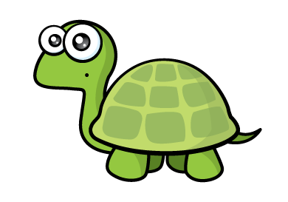
f-i-v-e
Have a think
six
4
7
greatest
smallest
From to
7
six
4
five

Slide 13
Have a go at the rest of the questions on the worksheet

