Slide 3
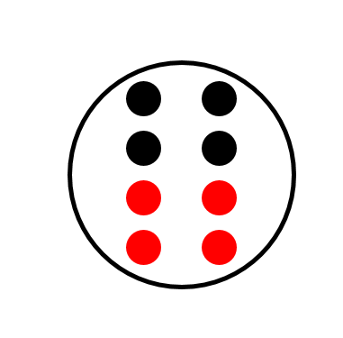
1) Show me one more than 9 using your fingers.
2) What is the missing number? 6, __ , 4, 3
3) How many dots?
4) Can you spell the number 1 less than 2

Slide 4
1) Show me one more than 9 using your fingers.
2) What is the missing number? 6, __ , 4, 3
3) How many dots?
4) Can you spell the number 1 less than 2
5
8
o-n-e

Slide 6
Looking at symbols
$$−$$
question mark
$$>$$
subtract
$$?$$
greater than
$$+$$
$$<$$
equals
$$=$$
add
less than

Slide 7
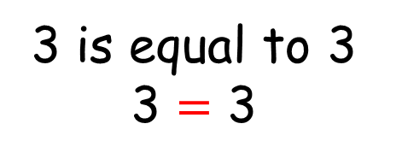
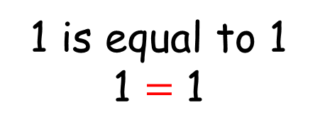
is equal to
$$=$$
1 is equal to 1
1 $=\text{1}$
2 is equal to 2
2 $=\text{2}$
3 is equal to 3
3 $=\text{3}$

Slide 8
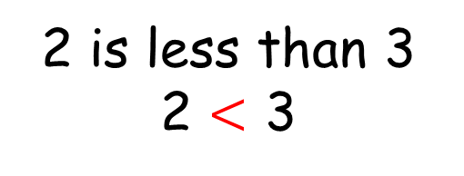
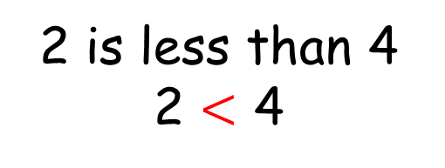
is less than
$$<$$
1 is less than 2
1 $<$ 2
2 is less than 3
2 $<$ 3
2 is less than 4
2 $<$ 4

Slide 9
is greater than
$$>$$
2 is greater than 1
2 $>$ 1
3 is greater than 2
3 $>$ 2
4 is greater than 2
4 $>$ 2

Slide 10
Have a go at questions 1 - 3 on the worksheet

Slide 11
greater than
less than
equal to
$$>$$
$$>$$
$$<$$
$$=$$
$$<$$
$$=$$

Slide 12
Have a think
greater than
less than
equal to
$$>$$
$$>$$
$$<$$
$$=$$
$$<$$
$$<$$
six
seven
eight
three
one
ten

Slide 13
Have a go at the last question on the worksheet

