Slide 3
1) How many carrots?
2) What is one more than 3?
3) What is one less than nine?
4) What number is missing? 9, 8, __ , 6

Slide 4
1) How many carrots?
2) What is one more than 3?
3) What is one less than nine?
4) What number is missing? 9, 8, __ , 6
five
4
8
7

Slide 6
Will every bucket get a spade?
How can we find out?
6
There are __ buckets.
6
There are __ spades.

Slide 7
Have a go at questions 1 and 2 on the worksheet

Slide 8
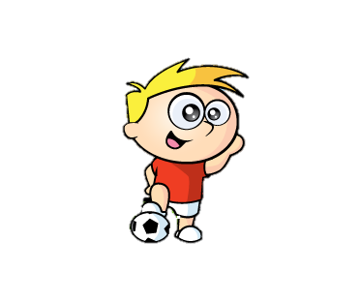
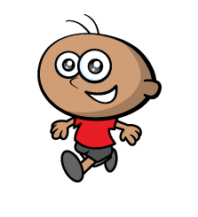
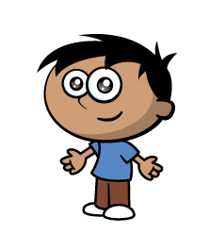
Everyone needs a ball to practise!

Slide 9
It’s ok, you can have mine Annie!
It’s time for a drink of water!
Have a think
7
There are __ players.
7
6
There are __ bottles of water.

Slide 10
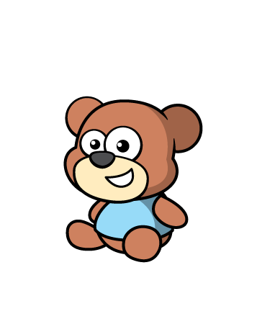
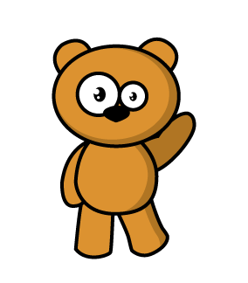
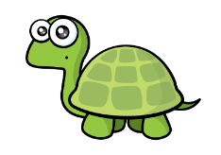
Have a think
5
There are __ teddy bears.
6
There are __ tarts.
I brought exactly
one treat for
each teddy bear!

Slide 11
Have a go at the rest of the questions on the worksheet

