Slide 3
1) Can you count to 5?
2) What number comes after 8?
3) What number is this? 6
4) What number is missing? 1, 2, __, 4

Slide 4
1, 2, 3, 4, 5
1) Can you count to 5?
2) What number comes after 8?
3) What number is this? 6
4) What number is missing? 1, 2, __, 4
9
six
3

Slide 6
How many strawberries are there?
Let’s count.

Slide 7
There are 5 strawberries.

Slide 8
Have a go at question 1 on the worksheet

Slide 9
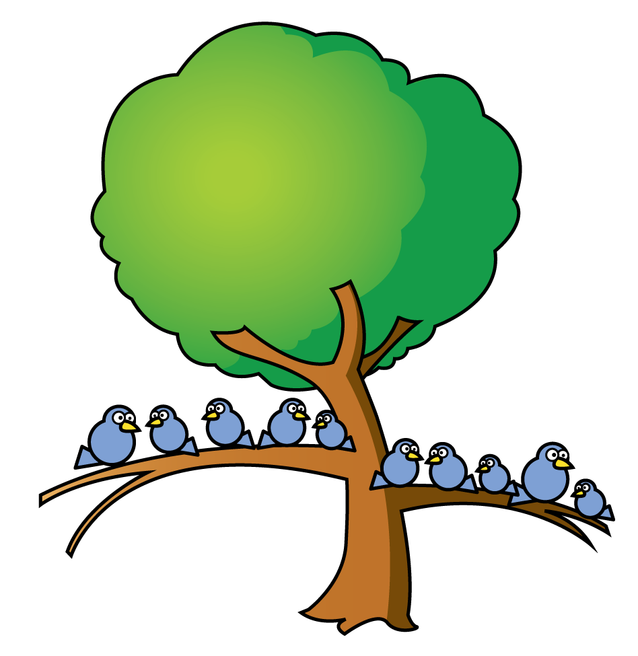
Have a think
How many birds are there?
Let’s count.

Slide 10
There are 9 birds on the tree.

Slide 11
Have a go at questions 2 and 3 on the worksheet

Slide 12
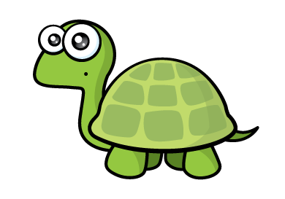
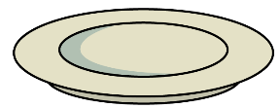
I counted 7 donuts.
How did you count them?

Slide 13
I used a ten frame!
There are 6 donuts on the plate.

Slide 14
Have a go at the rest of the worksheet

