Slide 3
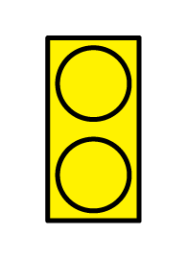
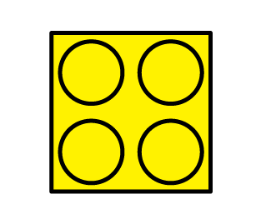
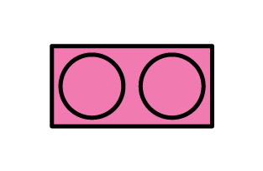
1) What colour is this?
2) What shape is this?
3) What is the same? What is different?
4) What is the same? What is different?

Slide 4
1) What colour is this?
2) What shape is this?
3) What is the same? What is different?
4) What is the same? What is different?
yellow
square
colour/ dots/ shape
size/ shape/ colour

Slide 6
Have a think
How can we sort these blocks?

Slide 7
We can sort by colour.

Slide 8
Have a go at question 1 on the worksheet

Slide 9
Have a think
What is another way to sort these objects?

Slide 10
squares
triangles
rectangles
We can sort by shape.

Slide 11
Have a go at question 2 on the worksheet

Slide 12
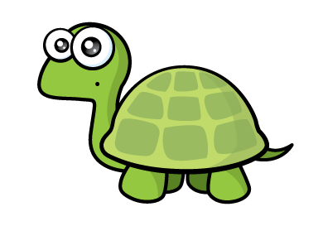
You can only sort these by colour or shape.
I can see another way to sort!

Slide 13
You can sort by colour like this
Or by shape like this

Slide 14
Can you see how I sorted these?

Slide 15
Have a go at the rest of the worksheet

