Slide 1
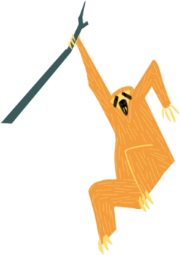
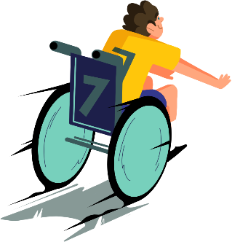
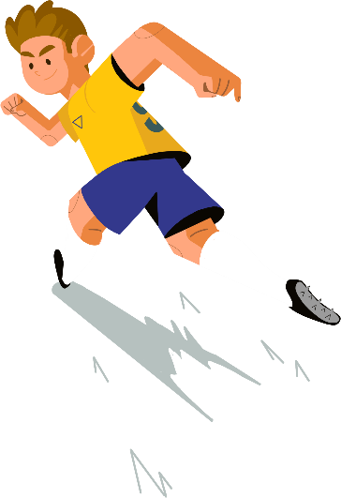
Lent Calendar 2020
February
26
27
28
March
2
3
4
5
6
9
10
11
12
13
16
17
18
19
20
23
24
25
26
27
April
30
31
1
2
3
6
7
8
9
10

Slide 2
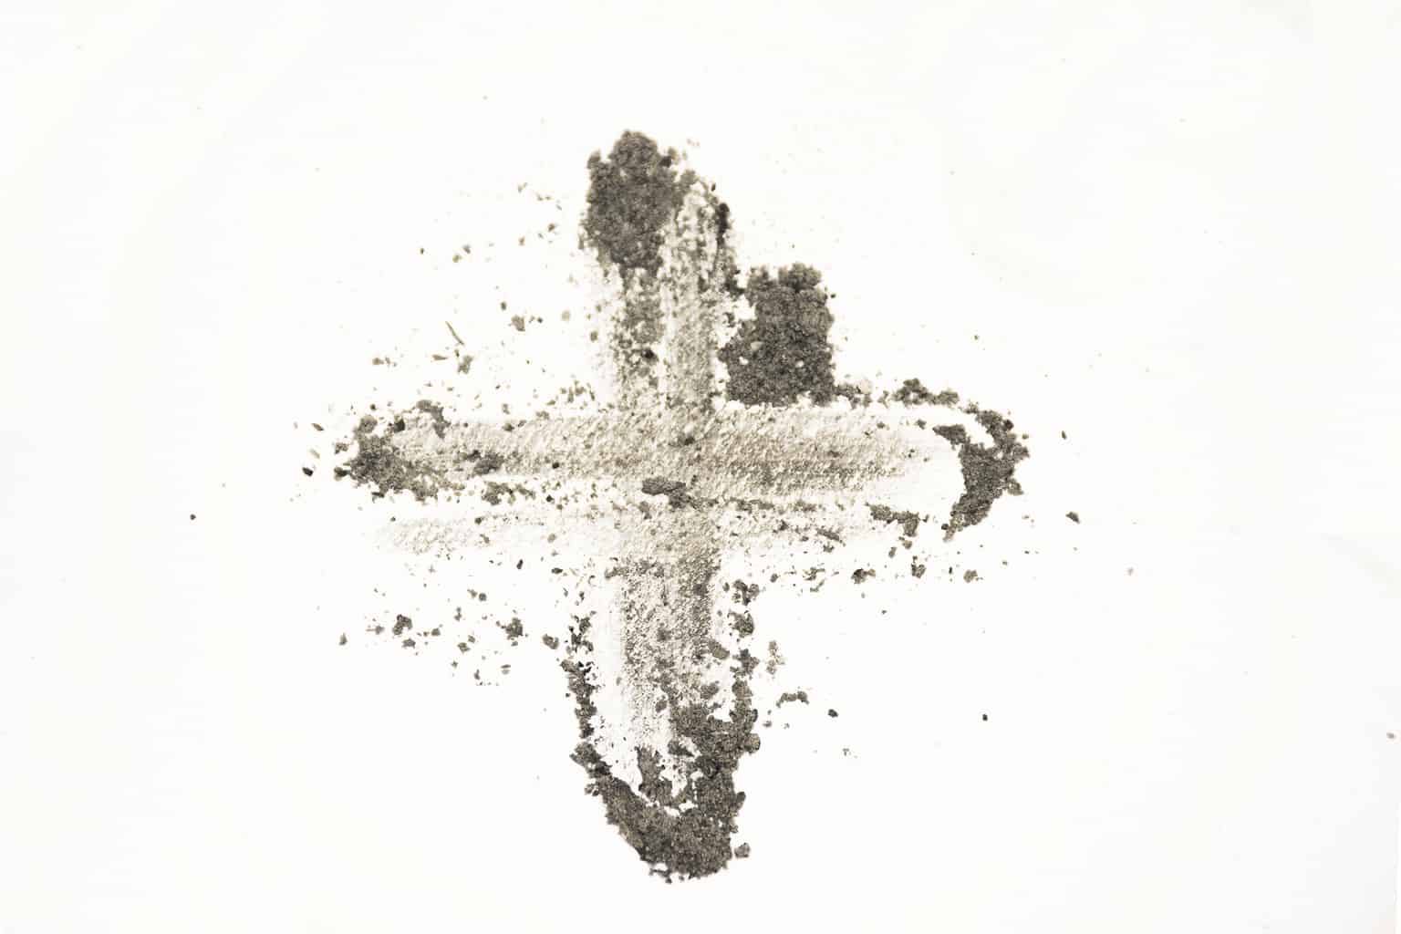
Wednesday 26 February
Think about…
As Lent begins, we remember how Jesus spent 40 days in the desert.
While Jesus was in the desert he had very little to eat or drink.
There are many people around the world who do not have the rights to basic things like enough food or clean water.
Throughout Lent we will think about our neighbours around the world who are defending their rights.
Click here for a Lent liturgy (perfect for Ash Wednesday)

Slide 3
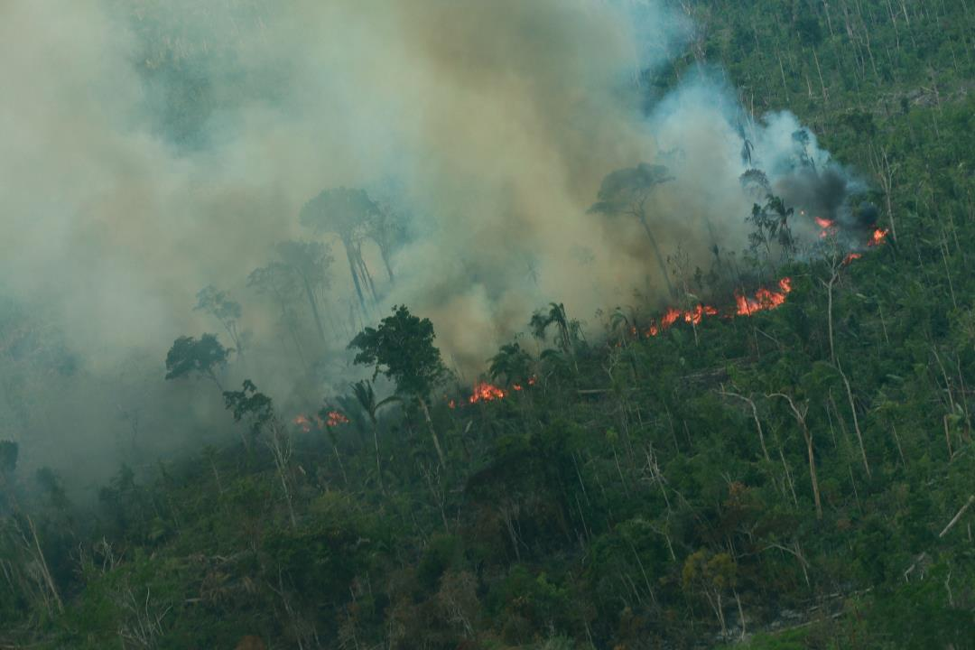
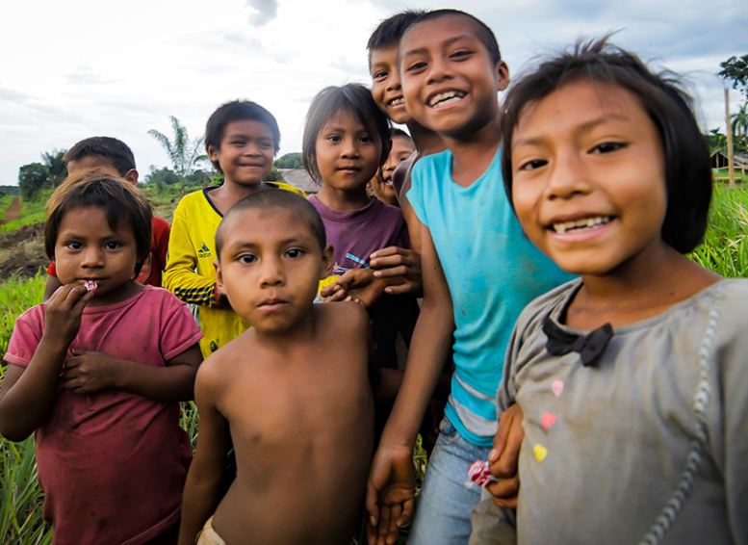
Thursday 27 February
Act
This Lent, we are thinking about the people who live in the Amazon rainforest area.
More than a football pitch of the rainforest is being lost every minute.
Watch our film to find out more

Slide 4
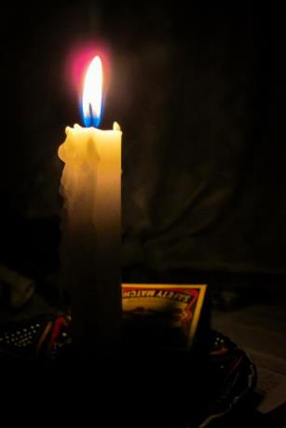
Friday 28 February
Pray
Light a candle and pray for all our global neighbours, using this film.

Slide 5
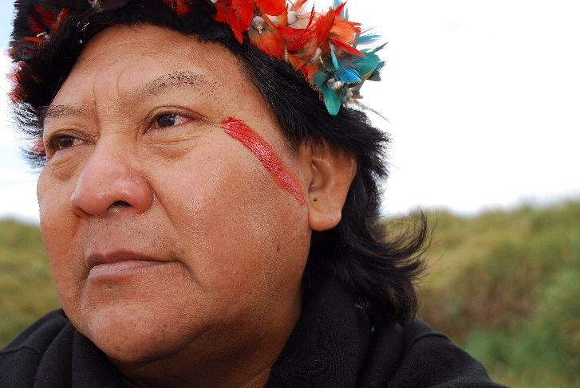
Monday 2 March
Pray
This is Davi. He lives in Brazil. He is part of a group called the Yanomami people, who live in the Amazon rainforest.
He says “Think of the Earth. It is life. The forest is life. Water is life.”
“We want them [the people in the cities] to listen and believe us…to see the pollution, destruction, poverty and illness.”
Loving God,
fill our hearts with compassion for the earth and all its peoples. Lead us to be good neighbours to all who are in need.
Amen

Slide 6
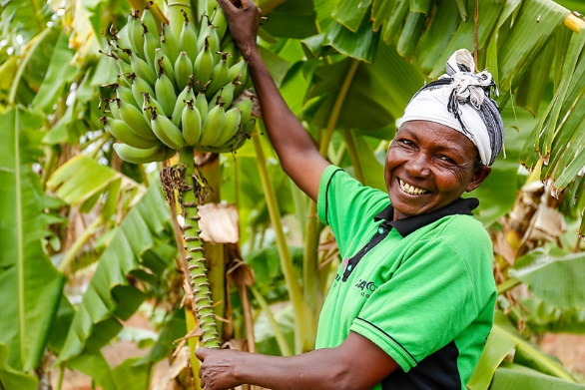
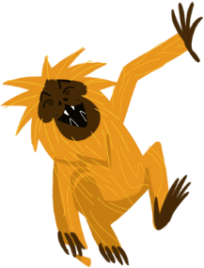
Tuesday 3 March
Act
It’s Fairtrade fortnight.
Find out whether your local shop sells Fairtrade Easter eggs. If not, ask them why not and if they will stock them next year.
Find our Fairtrade resources here

Slide 7
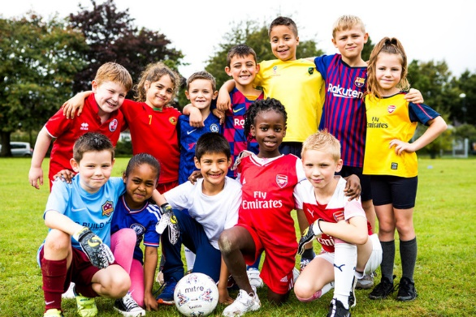
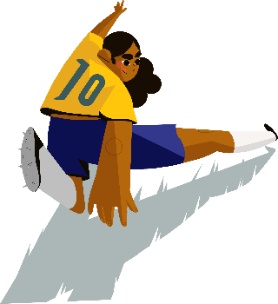
Wednesday 4 March
Pray
Give
This Lent, schools in England and Wales are holding fun football fundraisers to help the people of the Amazon.
Lord,
may my support bring hope to people who are in difficulty around the world.
May they know that you are with them and that they have sisters and brothers who care for them.
Amen
There are lots of ways you can do this!
Find out more at cafod.org.uk/primary

Slide 8
Thursday 5 March
Pray
Light a candle and say a prayer so all children around the world may have the basic things in life, like enough food or clean water.
Loving God,
Help us to work together to share what we have so that everyone has what they need.
Help us to build a better world where each of us can become the best person we can be.
Amen

Slide 9
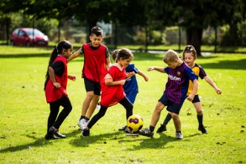
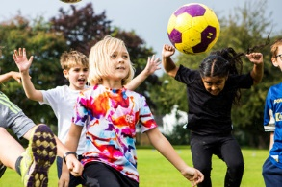
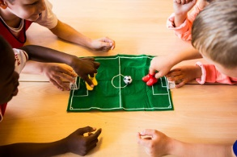
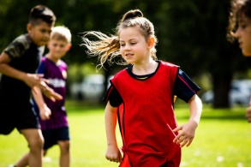
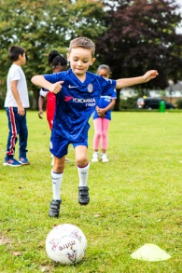
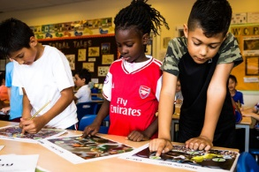
Friday 6 March
Today is Family Fast Day!
Hold a football fundraiser today to help people in the Amazon.
Use our Lent assembly today

Slide 10
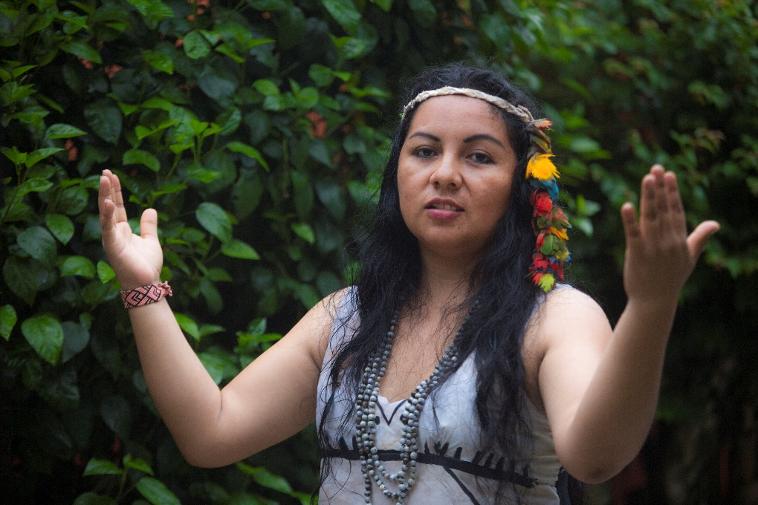
Monday 9 March
Pray
This is Yesica. She lives in Peru.
She is part of a group called the Harakbut people who live in an area of the Amazon rainforest.
She met Pope Francis when he visited the Amazon in 2018.
She says “The forest is our home, the river is our brother, as are all animals that live in the Amazon jungle.”
“Today this is being damaged, and we can no longer speak of living well while they destroy our home, the forest.”
Loving God,
fill our hearts with compassion for the earth and all its peoples. Lead us to be good neighbours to all who are in need.
Amen

Slide 11
Tuesday 10 March
Pray
Light a candle and pray for our Earth, using this film.

Slide 12
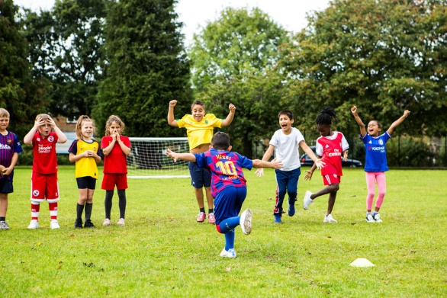
Wednesday 11 March
Pray
Penalty shootout!
Give
This Lent, schools in England and Wales are holding fun football fundraisers to help the people of the Amazon.
There are lots of ways you can do this!
Lord,
may my support bring hope to people who are in difficulty around the world.
May they know that you are with them and that they have sisters and brothers who care for them.
Amen
Find out more at cafod.org.uk/primary

Slide 13
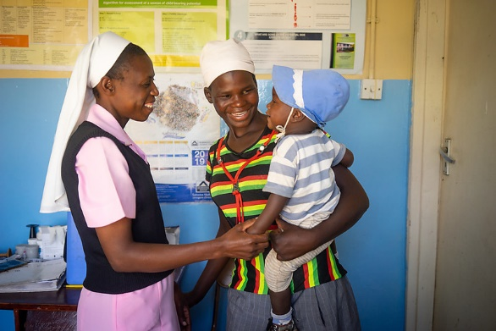
Thursday 12 March
Think about…
“I have come so that they may have life, and have it to the full”
John 10:10
Say these words together and spend some time today thinking about them.
Where do these words come from?
What do they mean?
How can we live by them?

Slide 14
Friday 13 March
Pray
Light a candle and say a prayer so all children around the world may have the basic things in life, like enough food or clean water.
Loving God,
Help us to work together to share what we have so that everyone has what they need.
Help us to build a better world where each of us can become the best person we can be.
Amen

Slide 15
Monday 16 March
Pray
This is Wanem. She lives in Brazil. She is part of a group called the Kanamari people, who live in the Amazon.
CAFOD has supported people like Wanem to learn about their rights.
She says, “Today we suffer more and more from seeing our land reduced and trees cut down.”
The people have been learning about what rights they have, and how to defend the land.
Loving God,
fill our hearts with compassion for the earth and all its peoples. Lead us to be good neighbours to all who are in need.
Amen

Slide 16
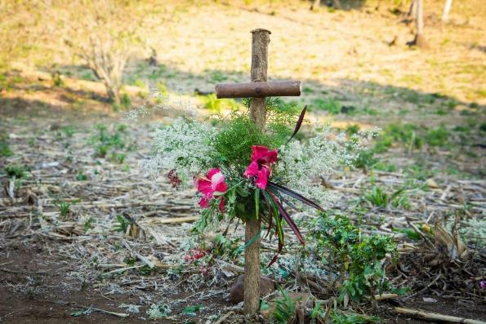
Tuesday 17 March
Pray
Reflect on one of the Stations of the Cross today.

Slide 17
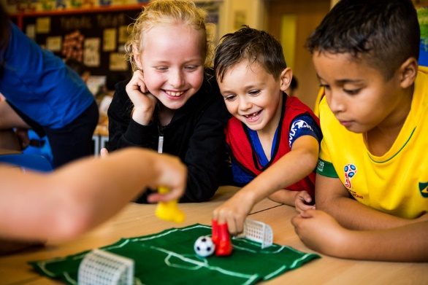
Wednesday 18 March
Finger football!
Pray
Give
This Lent, schools in England and Wales are holding fun football fundraisers to help the people of the Amazon.
There are lots of ways you can do this!
Lord,
may my support bring hope to people who are in difficulty around the world.
May they know that you are with them and that they have sisters and brothers who care for them.
Amen
Find out more at cafod.org.uk/primary

Slide 18
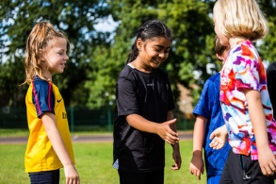
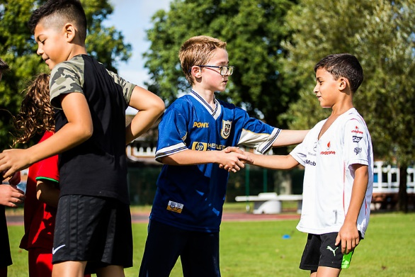
Thursday 19 March
Act
What action will you take to show kindness to others today?
Think of at least three things you can do today and during the next week of Lent.
You could think of three different people to show kindness to, maybe someone you don’t always get on with or someone you wouldn’t normally talk to.

Slide 19
Friday 20 March
Act
Today is International Day of Happiness.
What action will you take to show kindness to others?
Think of at least three things you can do today and during the next week of Lent to help bring happiness to other people.
Notes:
Photo credit: Zinyange Autony

Slide 20
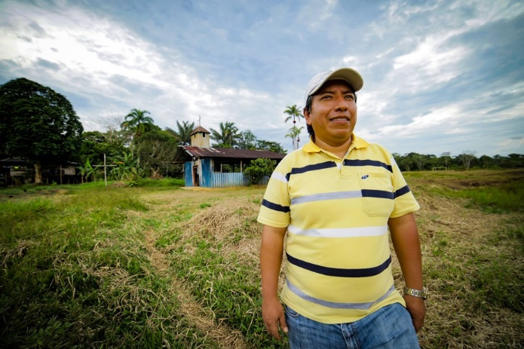
Monday 23 March
Pray
This is Fr Edwin. He lives in Colombia. He has been helping people living in the Amazon area for many years.
The area the people live in is under threat from mining companies.
He says “The wealth of these people is breathtaking. Mining would cause serious damage to the community and water sources.”
Loving God,
fill our hearts with compassion for the earth and all its peoples. Lead us to be good neighbours to all who are in need.
Amen

Slide 21
Tuesday 24 March
Pray
Reflect on one of the Stations of the Cross today.

Slide 22
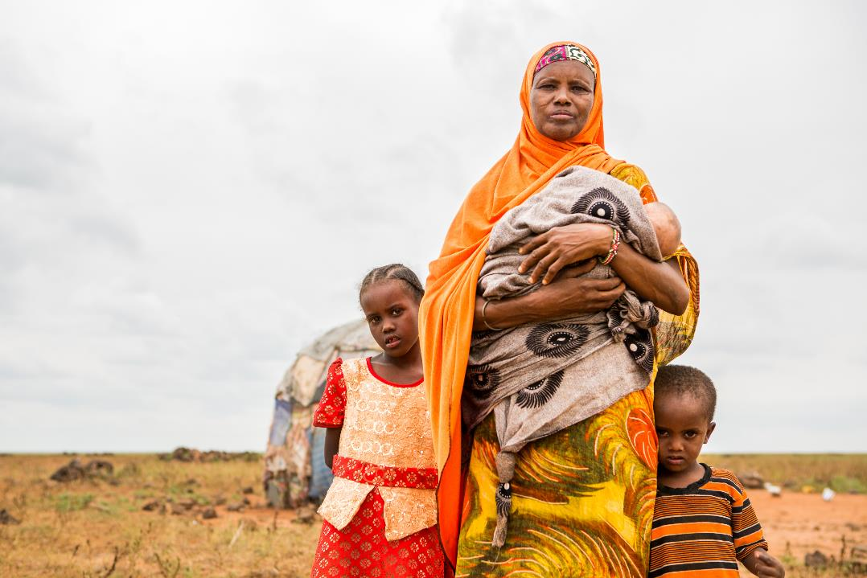
Wednesday 25 March
Pray
Today we celebrate a special day called the Annunciation.
It’s the day when we celebrate the angel Gabriel visiting Mary to tell her the good news that she would be the mother of Jesus.
Let us pray
Hail Mary, full of grace, the Lord is with thee;
blessed art thou among women, and blessed is the fruit of thy womb, Jesus.
Find our annunciation resources here
Holy Mary Mother of God,
pray for us sinners,
now and at the hour of our death.
Amen

Slide 23
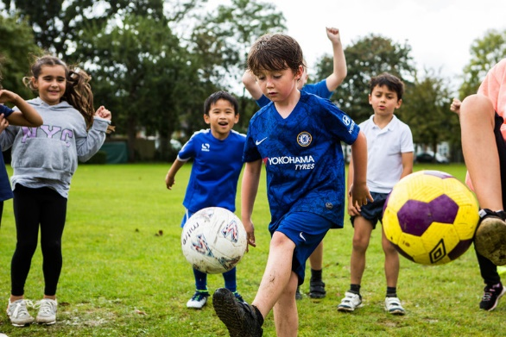
Thursday 26 March
Keepie Uppie competition!
Pray
Give
This Lent, schools in England and Wales are holding fun football fundraisers to help the people of the Amazon.
There are lots of ways you can do this!
Lord,
may my support bring hope to people who are in difficulty around the world.
May they know that you are with them and that they have sisters and brothers who care for them.
Amen
Find out more at cafod.org.uk/primary

Slide 24
Friday 27 March
Pray
Light a candle and say a prayer so all children around the world may have the basic things in life, like enough food or clean water.
Loving God,
Help us to work together to share what we have so that everyone has what they need.
Help us to build a better world where each of us can become the best person we can be.
Amen

Slide 25
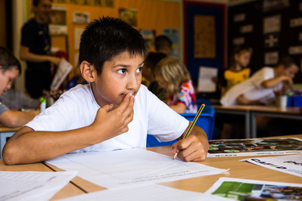
Monday 30 March
Act
Easter is nearly here.
Start getting ready by making Easter cards for your family and friends.
Creator God,
open our eyes to see your love throughout creation.
Inspire us to treat creation and each other as you would, with respect.
Amen.

Slide 26
Tuesday 31 March
Pray
Reflect on one of the Stations of the Cross today.

Slide 27
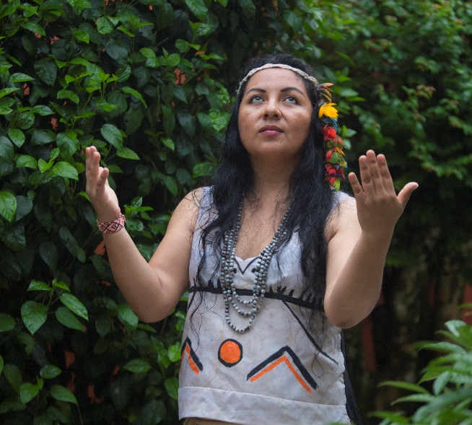
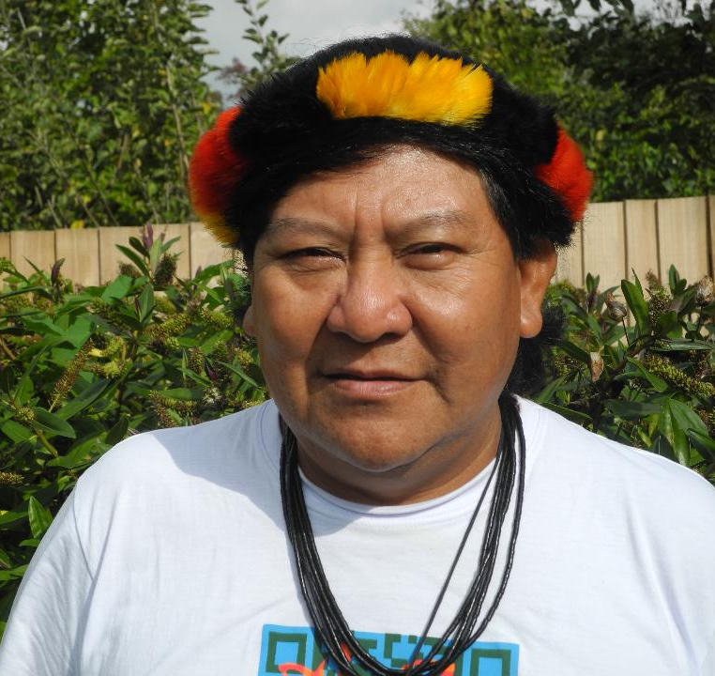
Wednesday 1 April
Give
There is still time to hold your fun football fundraiser this Lent.
Find out more at cafod.org.uk/primary

Slide 28
Thursday 2 April
Pray
Light a candle and say a prayer so all children around the world may have the basic things in life, like enough food or clean water.
Loving God,
Help us to work together to share what we have so that everyone has what they need.
Help us to build a better world where each of us can become the best person we can be.
Amen

Slide 29
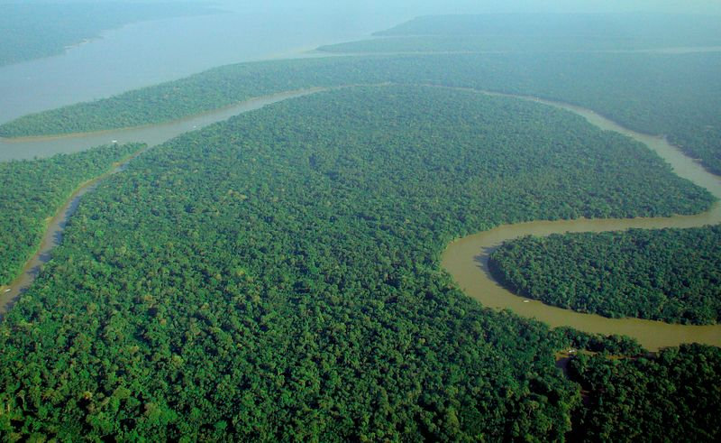
Friday 3 April
Pray
This Lent we have heard stories from people in different countries around the Amazon.
Pray for all the people of the Amazon.

Slide 30
Monday 6 April
Pray
This Lent, we are thinking about the people who live in the Amazon rainforest.
At least one football pitch of the forest is being lost every minute.
Creator God,
open our eyes to see your love throughout creation.
Inspire us to treat creation and each other as you would, with respect.
Amen

Slide 31
Tuesday 7 April
Pray
Reflect on one of the Stations of the Cross today.

Slide 32
Wednesday 8 April
Pray
Light a candle and say a prayer so all children around the world may have the basic things in life, like enough food or clean water.
Loving God,
Help us to work together to share what we have so that everyone has what they need.
Help us to build a better world where each of us can become the best person we can be.
Amen

Slide 33
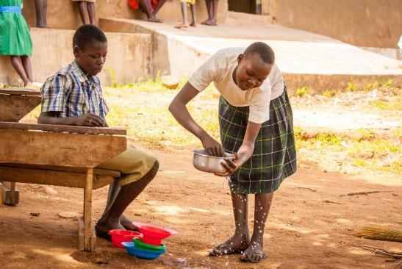
Thursday 9 April
Think about…
Holy Thursday
Today Jesus washed his disciples feet at the Last Supper.
Think about how you can serve others.

Slide 34
Friday 10 April
Pray
Good Friday
Say a prayer today for people around the world who live in poverty.
Remember those families that do not have basic things like food, housing and clothing.

