Slide 2
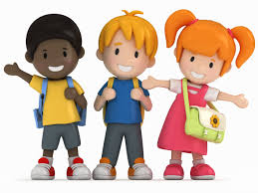
There are about 11 million (11,000000)
children in the United Kingdom.
Around 500 of them are here at our school.

Slide 3
Universal Children's Day 2019. Universal Children's Day is celebrated annually on 20th November.
The goal of Universal Children's day is to improve child welfare worldwide, promote and celebrate children's rights and promote togetherness and awareness amongst all children.

Slide 4
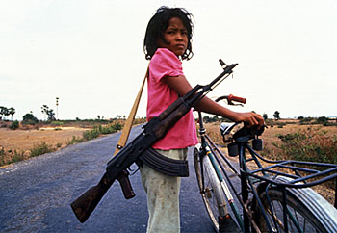
250,000 children are child soldiers.
It is not a game.

Slide 5
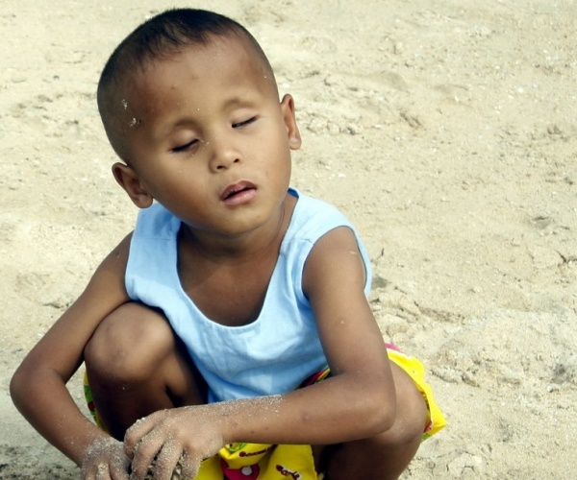
500,000 children are blind because of Vitamin A deficiency.
This could have been prevented if they took a tiny tablet, costing a few pennies.
Why do you think they didn’t get enough Vitamin A?

Slide 6
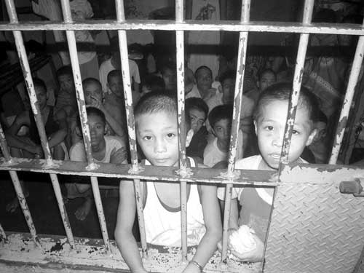
More than 1 million children are in prison – often they have not committed a crime.
These two boys (aged 9 & 10) are in prison, accused of stealing food.

Slide 7
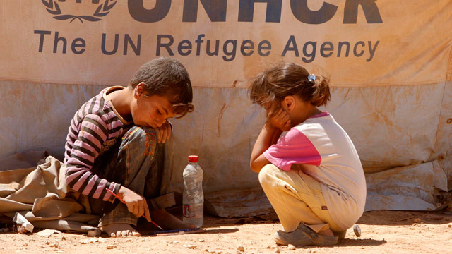
Each year, more than 10 million children become refugees – driven from their homes by conflict.
Where do you think these children have come from?
Why are they in a refugee camp?

Slide 8
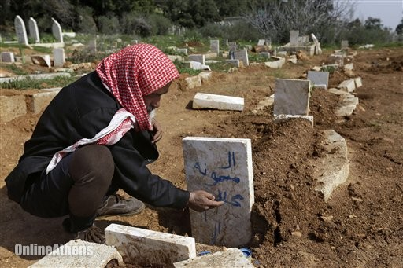
Every year, 6 million children under the age of 5 die from easily preventable causes.
That’ s 16,000 children every day.

Slide 9
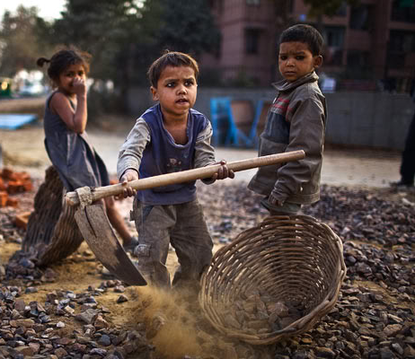
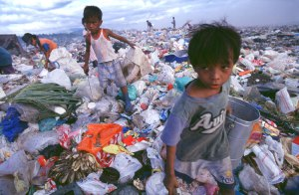
More than 240 million children work, many of them in dangerous conditions.
More than 70 million children under the age of 10 are working.

Slide 10
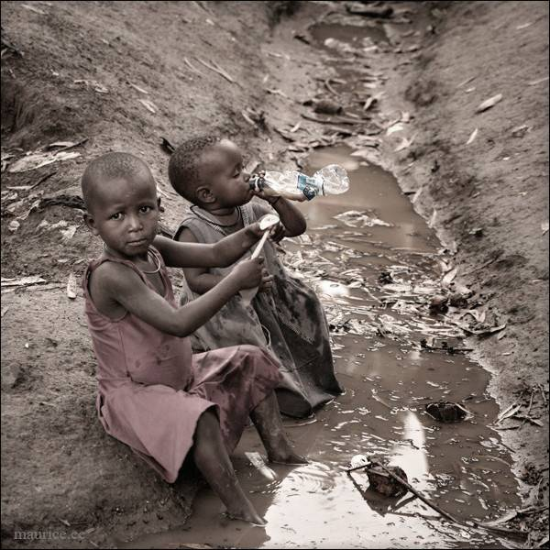
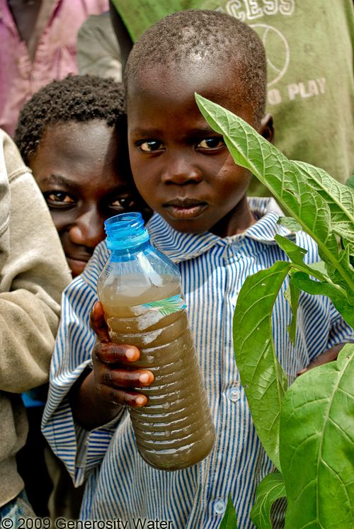
More than 400 million children do not have clean water to drink.

Slide 11
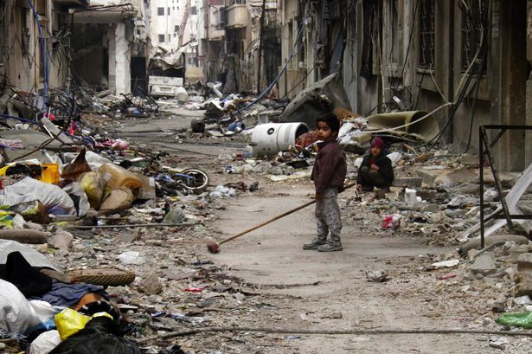
What right do you think is most important for children everywhere?
2. What right would you most hate to lose?
3. What can we do to see that all the children in this school enjoy their rights?
4. What can we do to
help some of the
children we have
heard about get their
rights?

Slide 12
Reflection
Light CaNdle
Together say Prayer on next slide linked to World Children’s Day.

Slide 13
https://www.youtube.com/watch?v=I_uDUSzzSUo
LISTEN

